Slide 1
VA 101

Slide 2
Why arsenal haven’t won the league in the last decade??? - Vaastav anand

Slide 3
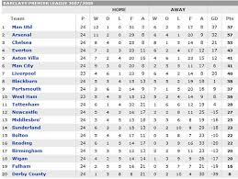
What data did I use?
https://github.com/footballcsv/en-england
Date | Home Team | Away Team | FT Score | HT Score
2013-08-17 | Arsenal | Aston Villa | 1-3 | 1-1

Slide 4
IS IT BECAUSE….
We have been absolutely abysmal?
We don’t have what it takes?
Other teams have been better than us?
It’s a voodoo ploy by the good for nothing Spuds.

Slide 5
IS IT BECAUSE….
We have been absolutely abysmal?
We don’t have what it takes?
Other teams have been better than us?
It’s a voodoo ploy by the good for nothing Spuds.

Slide 6
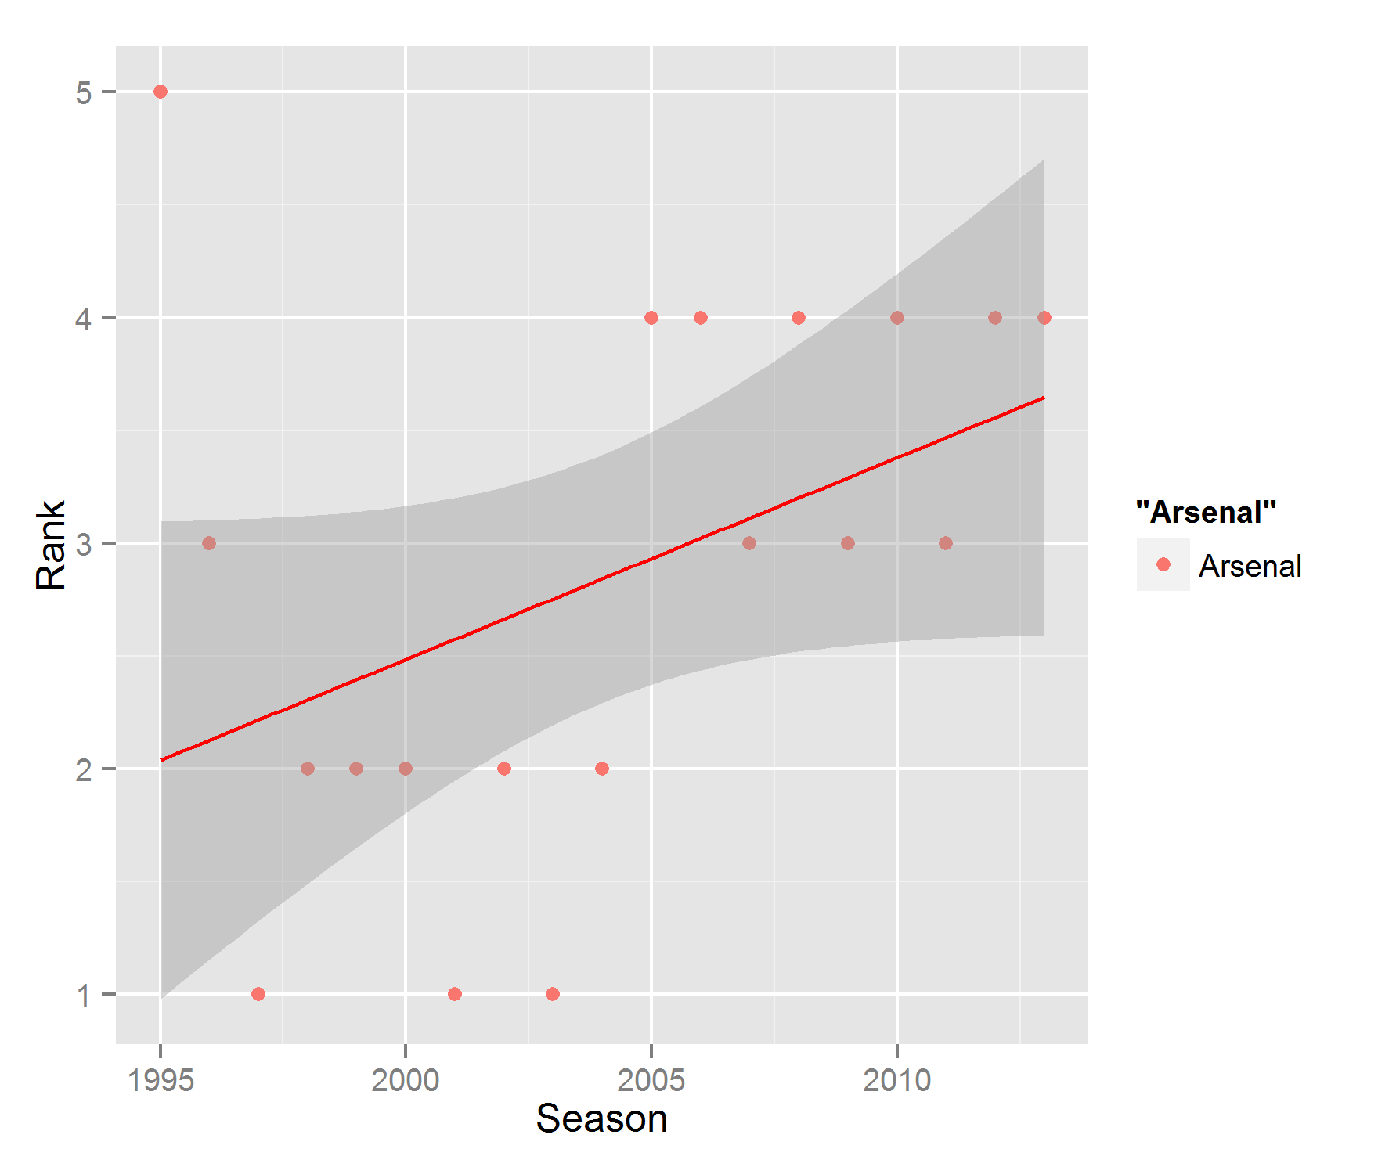

Slide 7
IS IT BECAUSE….
We have been absolutely abysmal?
We don’t have what it takes?
Other teams have been better than us?
It’s a voodoo ploy by the good for nothing Spuds.

Slide 8
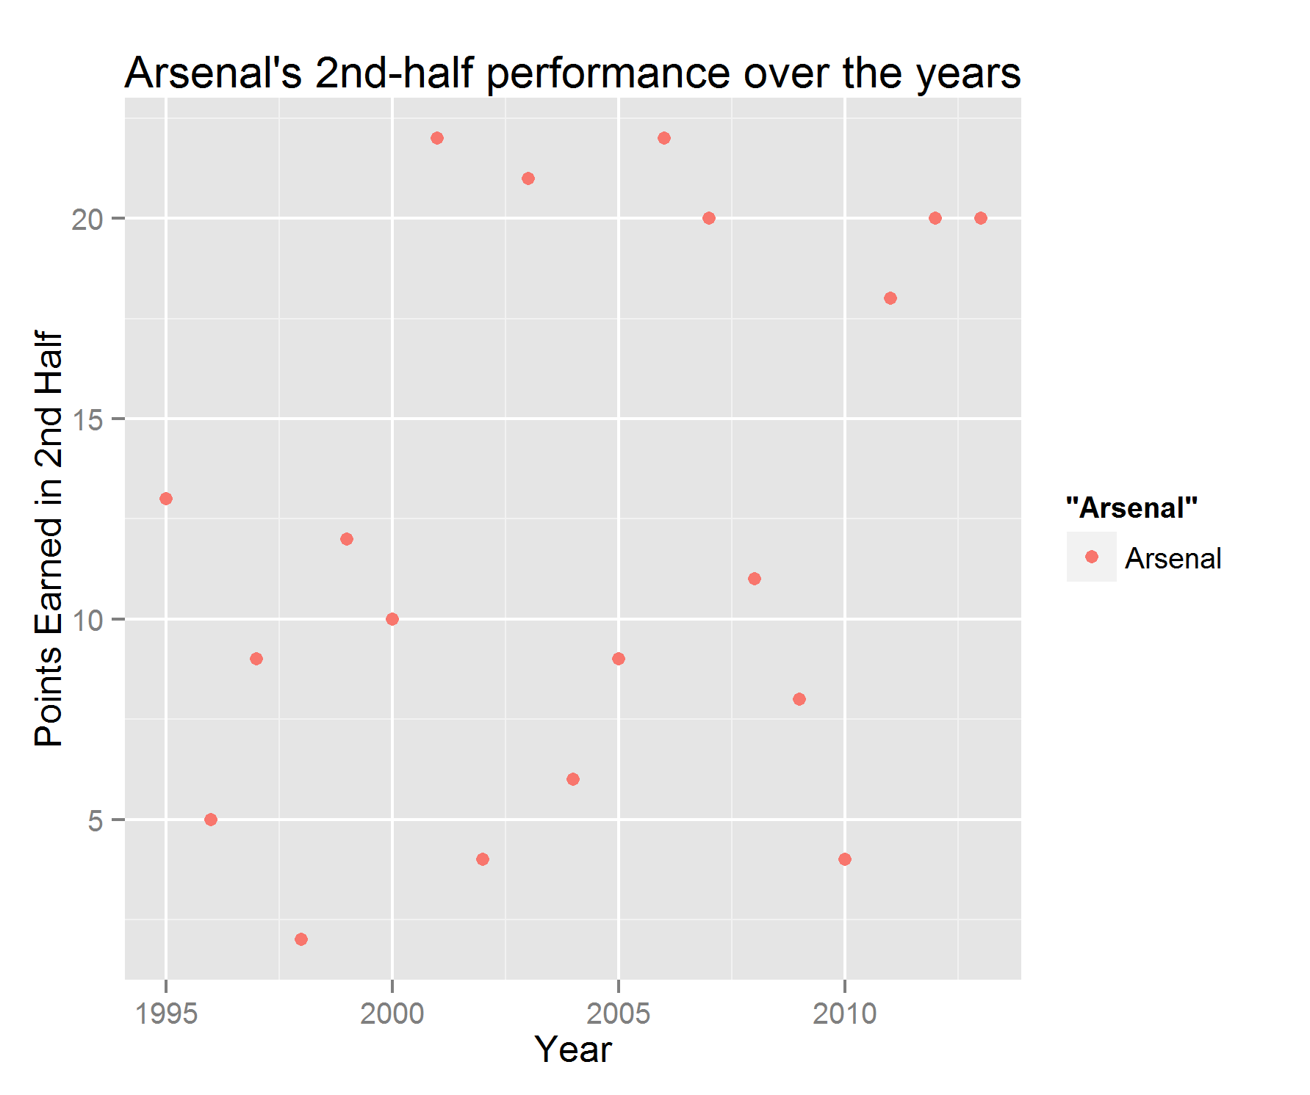

Slide 9
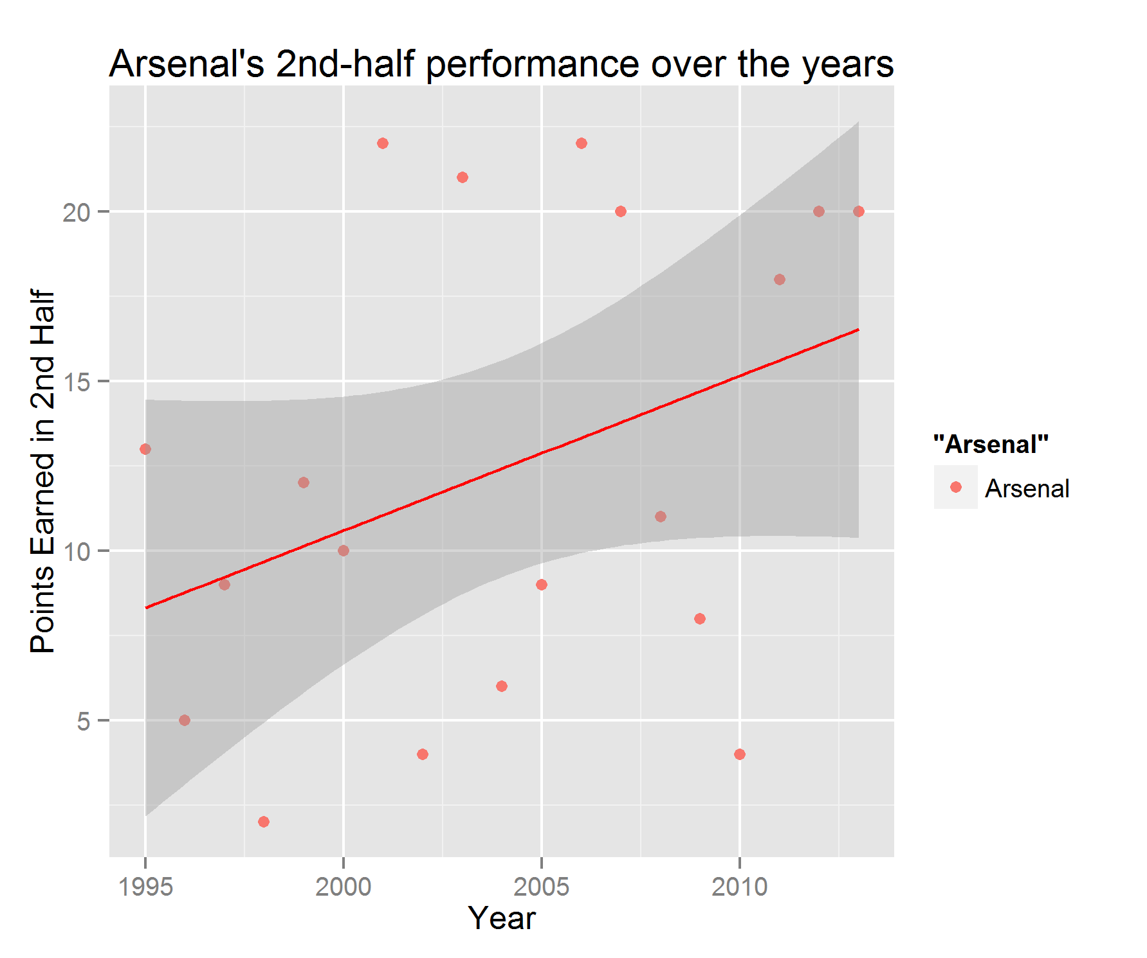

Slide 10
IS IT BECAUSE….
We have been absolutely abysmal?
We don’t have what it takes?
Other teams have been better than us?
It’s all a voodoo ploy by the good for nothing Spuds.(What do you think of Tottenham?)

Slide 11

YEAH….NO. DEFINITELY NOT THAT!

Slide 12
IS IT BECAUSE….
We have been absolutely abysmal?
We don’t have what it takes?
Other teams have been better than us?
It’s a voodoo ploy by the good for nothing Spuds.(What do you think of Tottenham?)

Slide 13
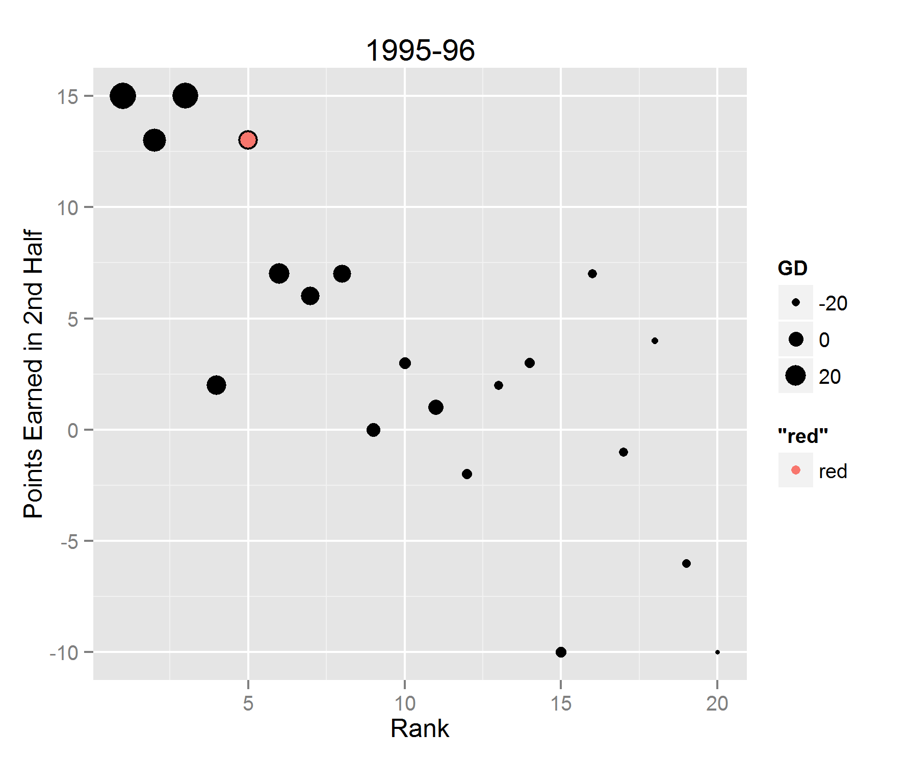
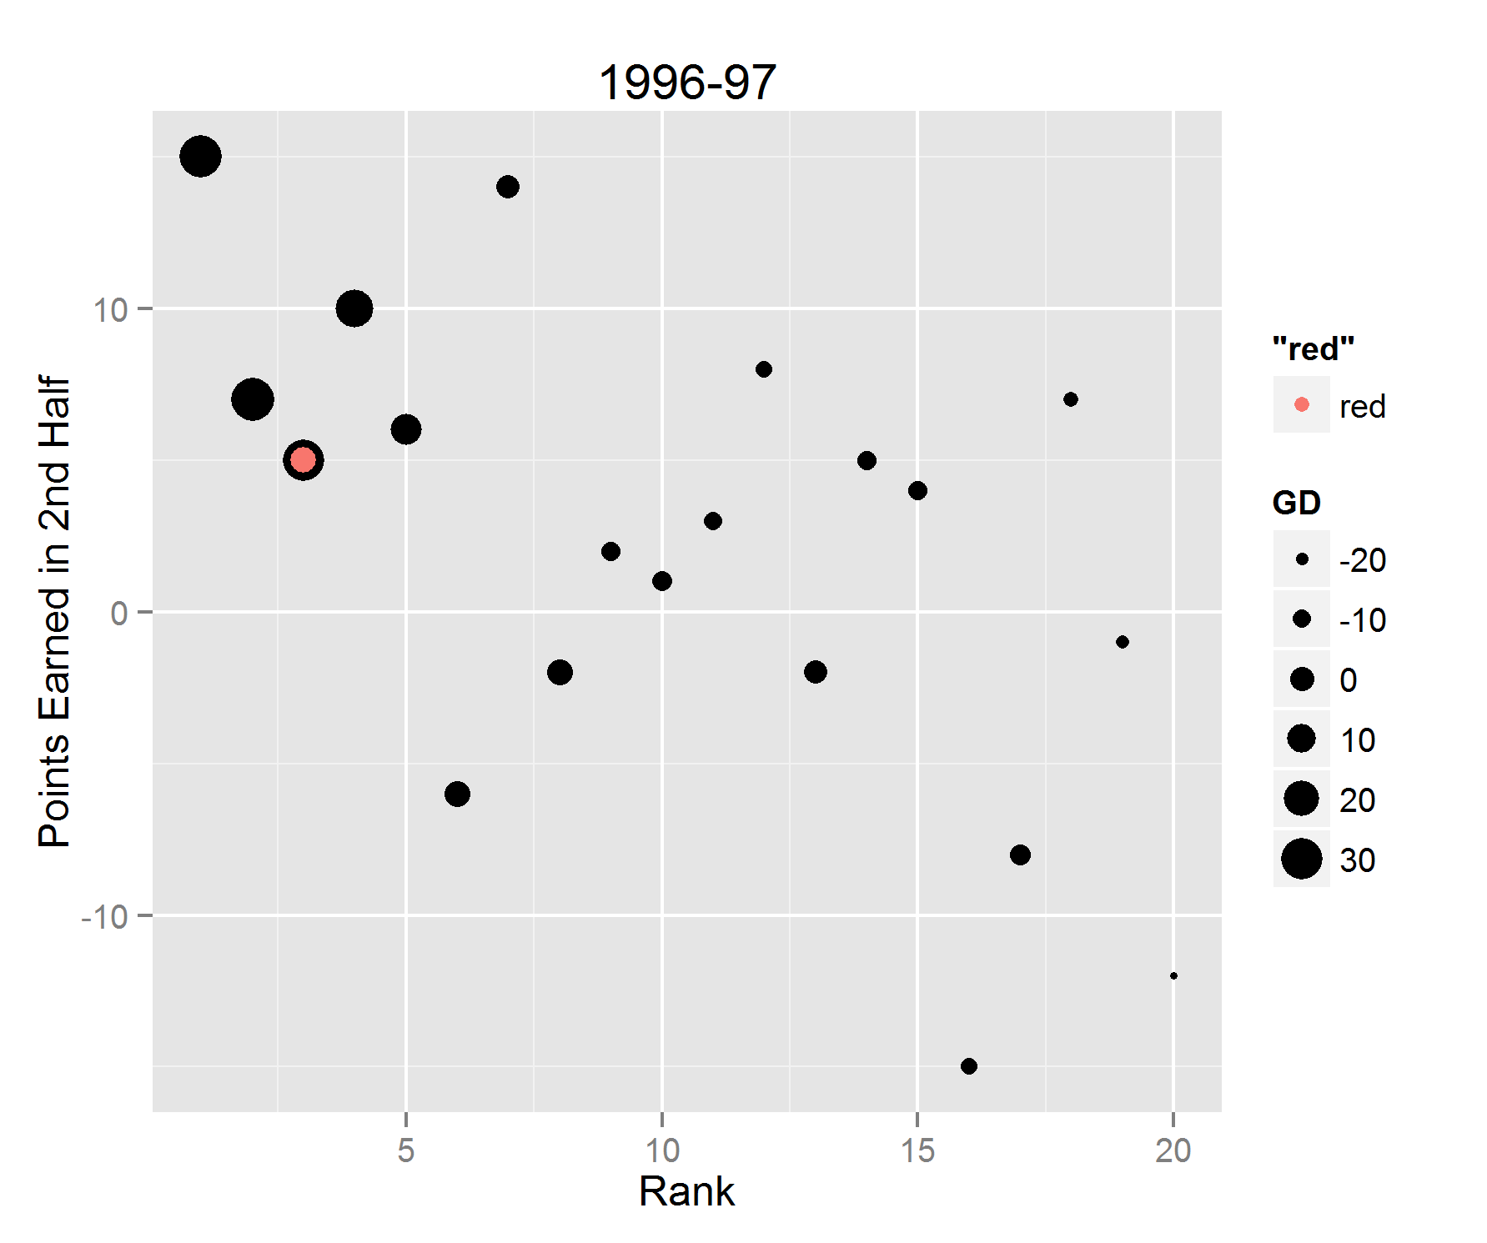
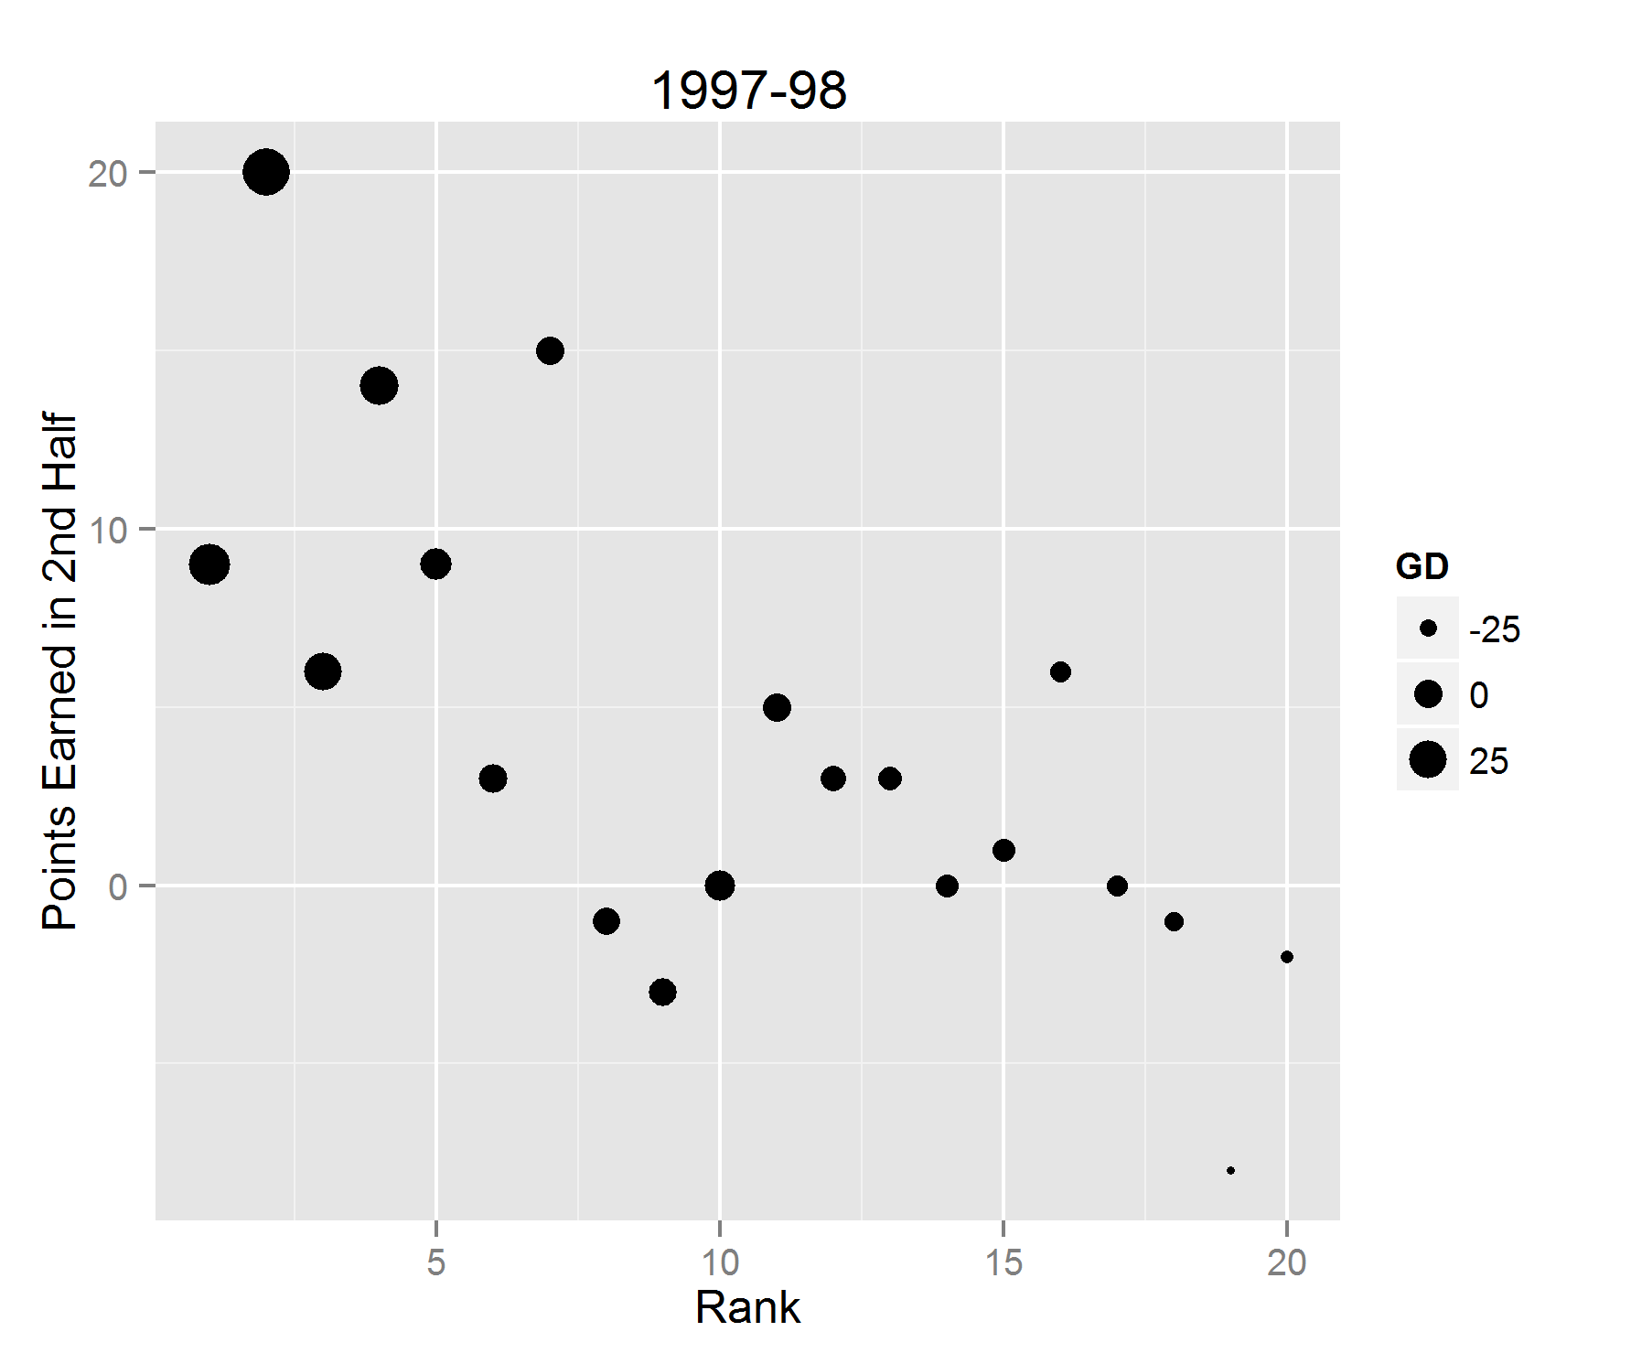
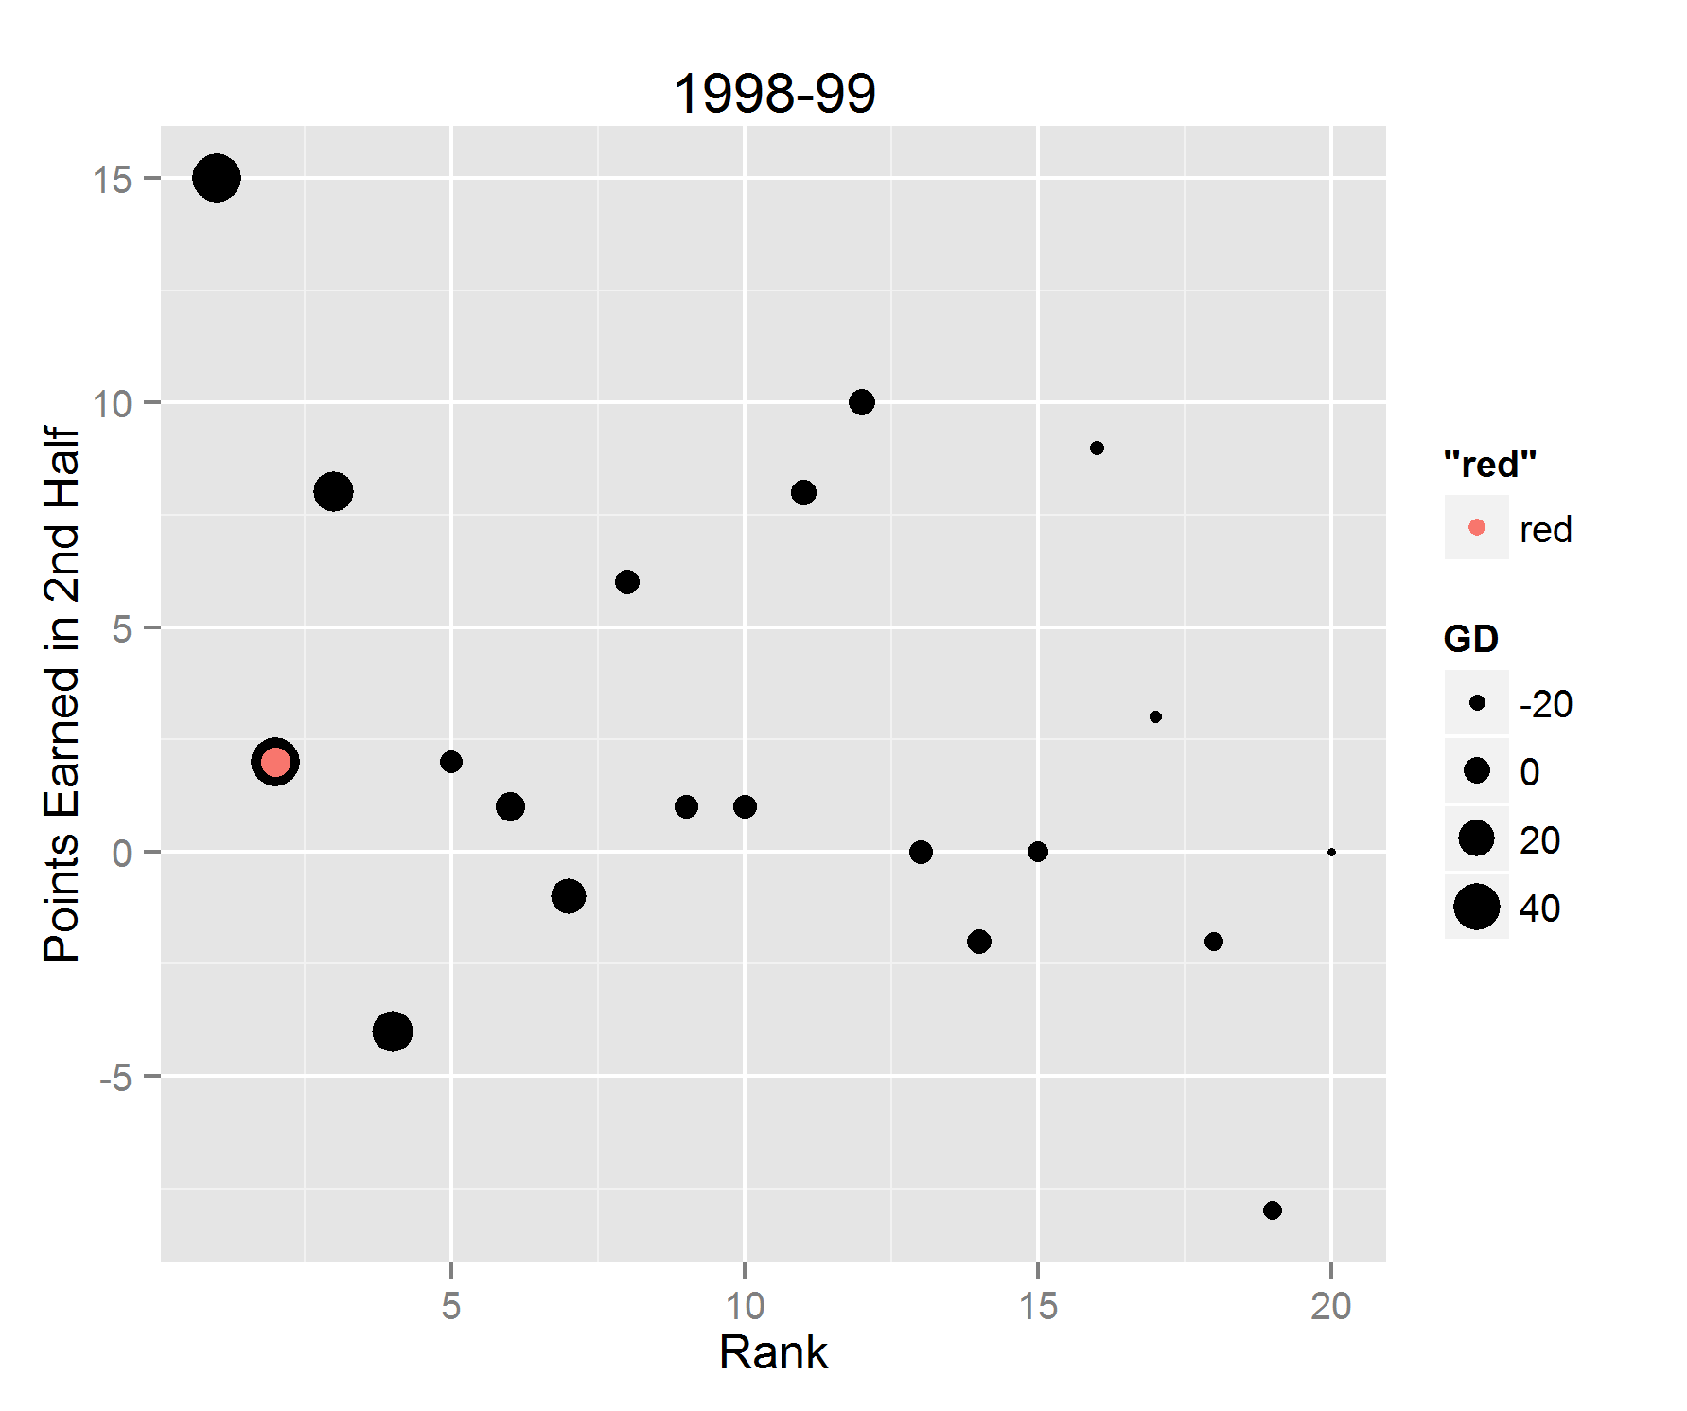
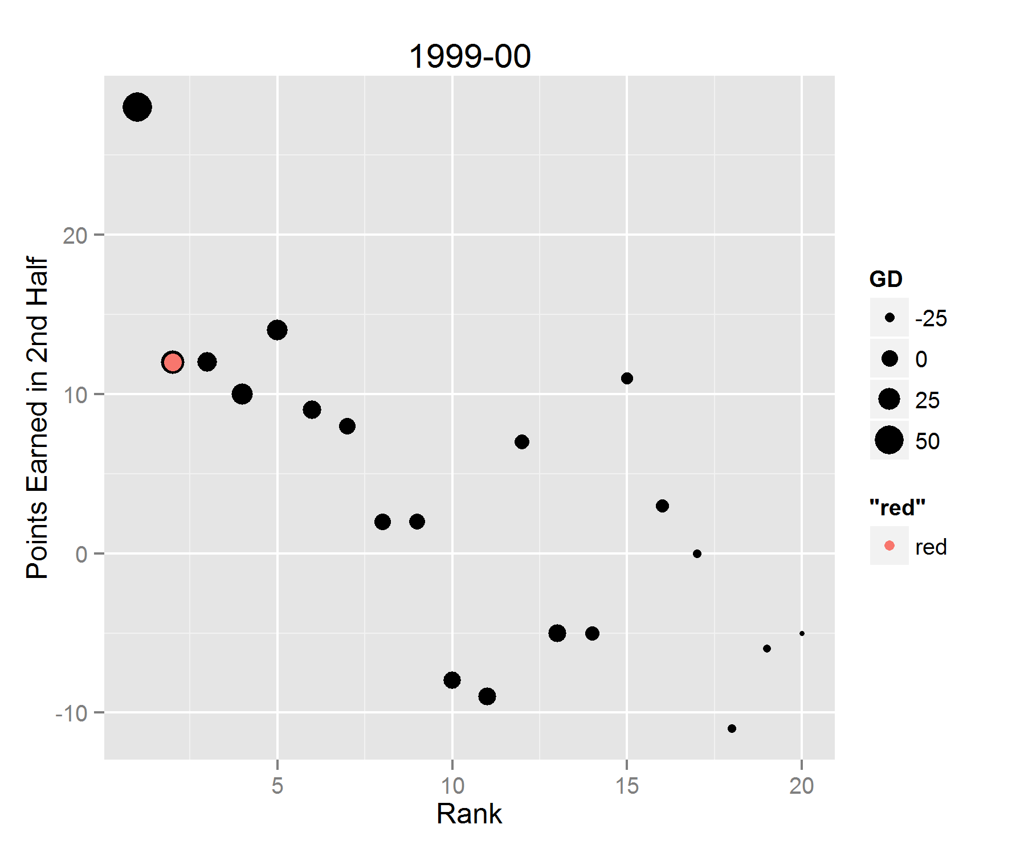
THE 90s

Slide 14
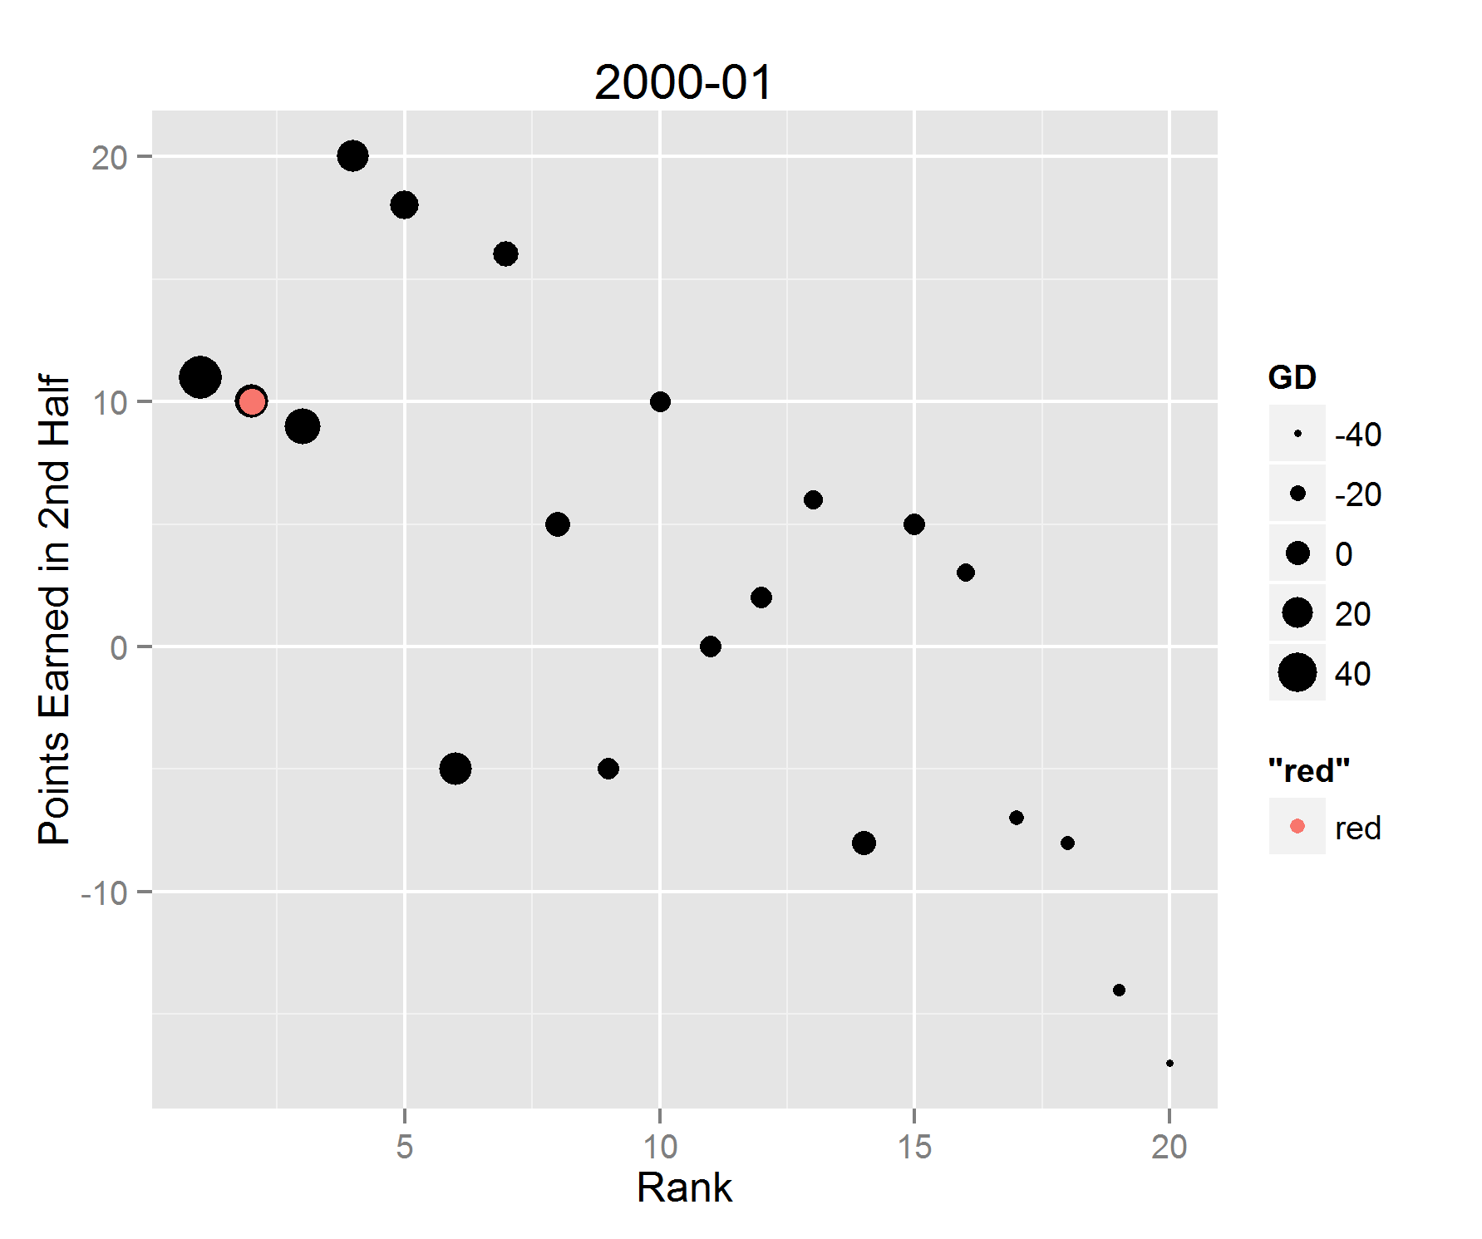
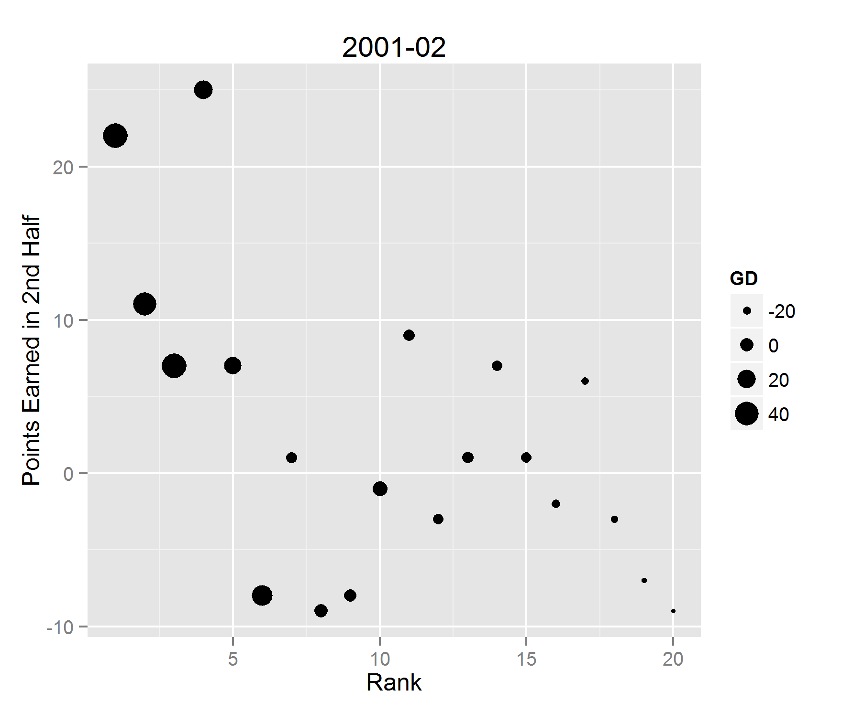
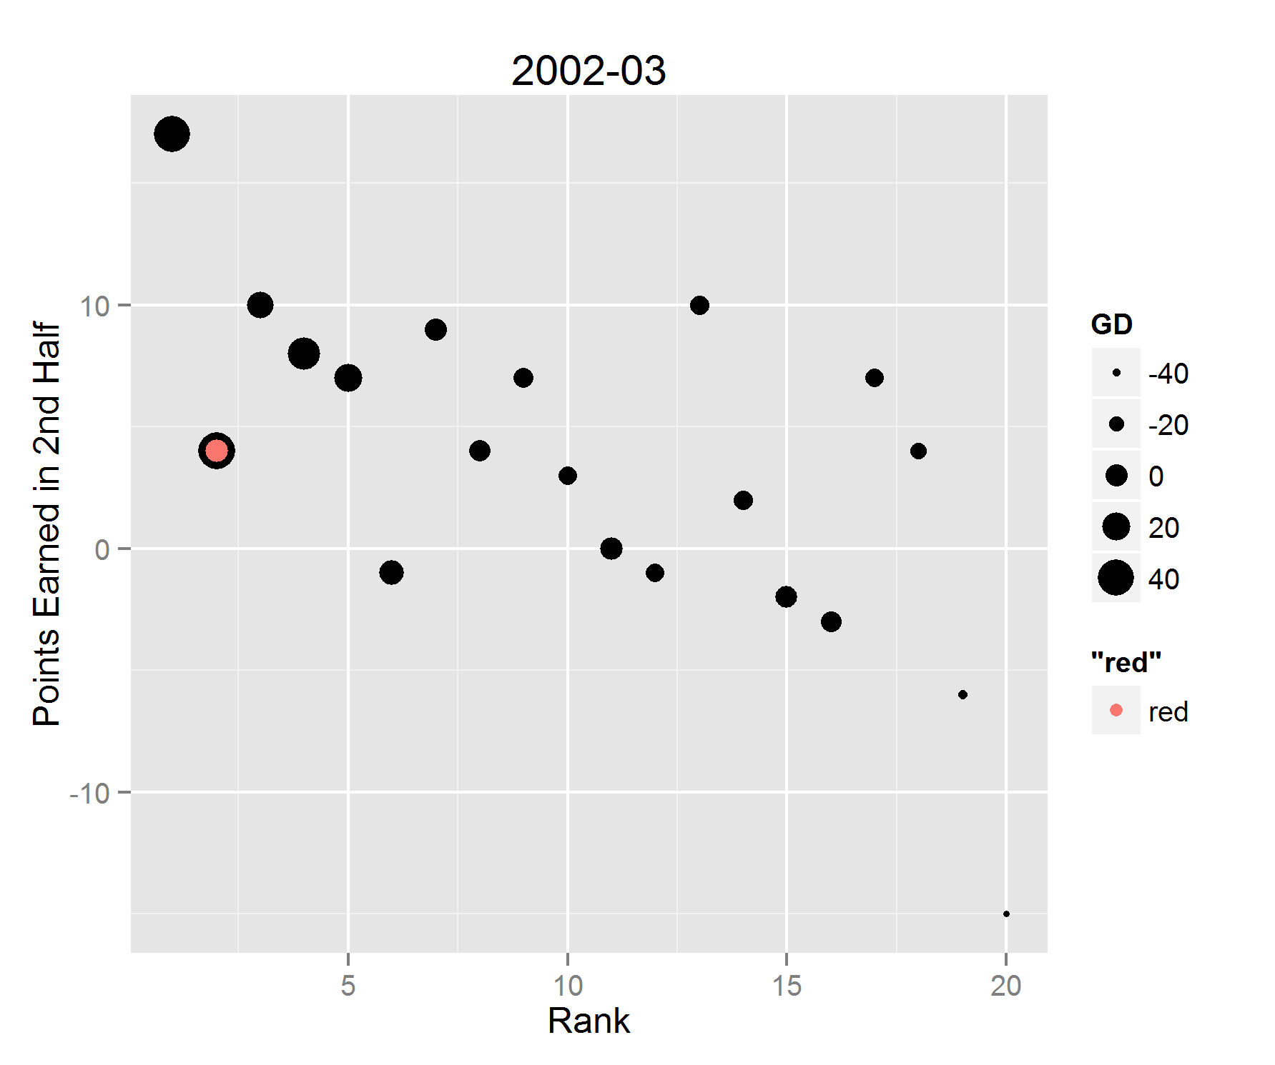
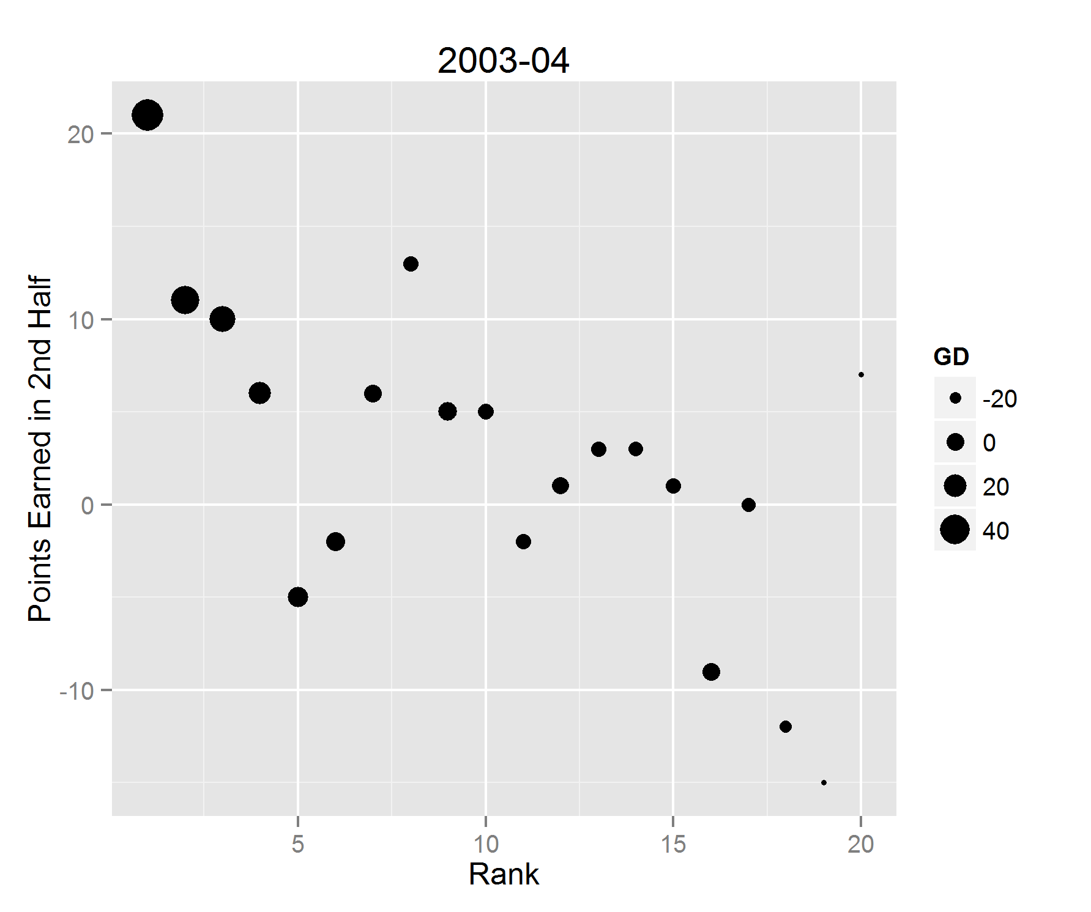
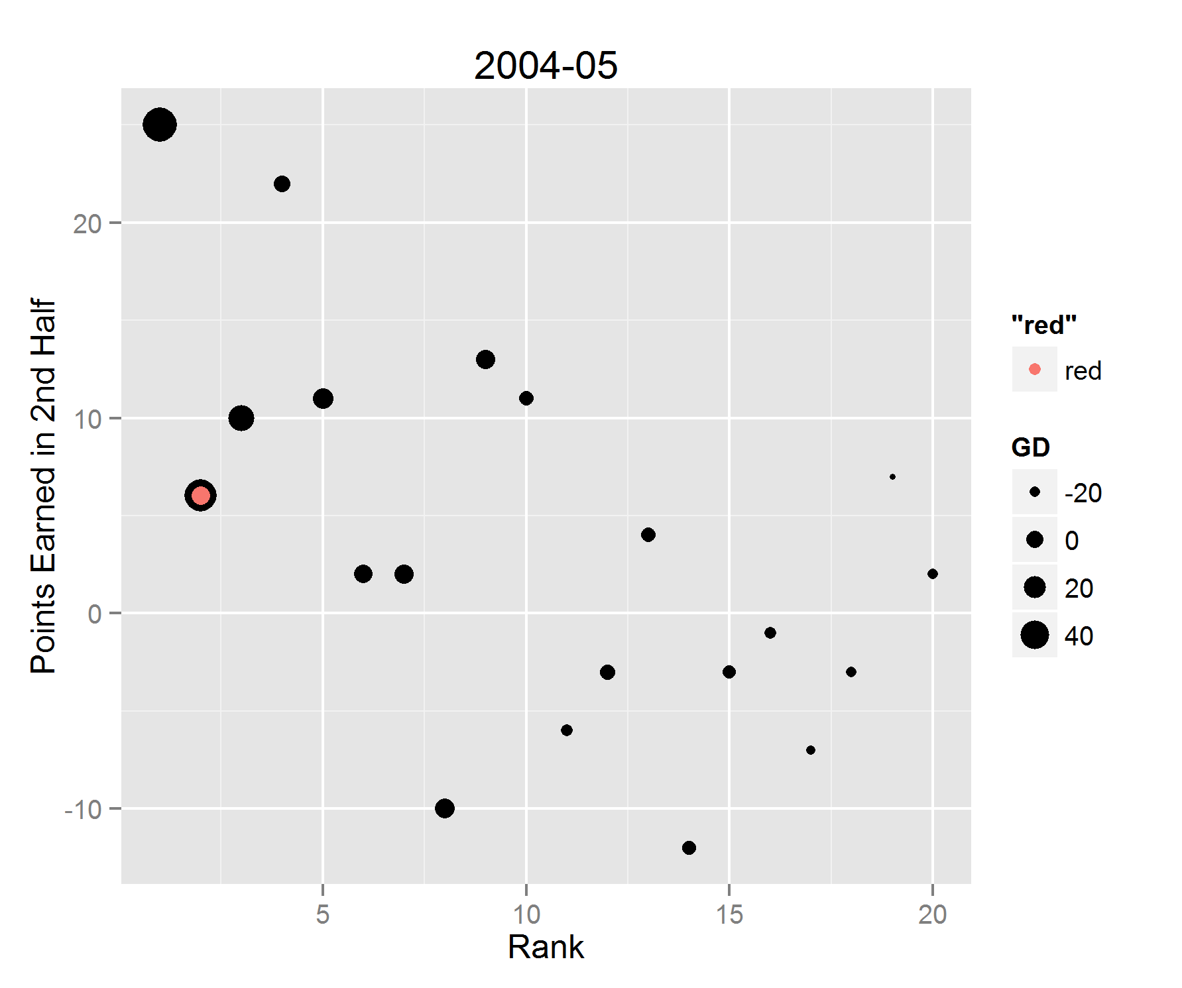
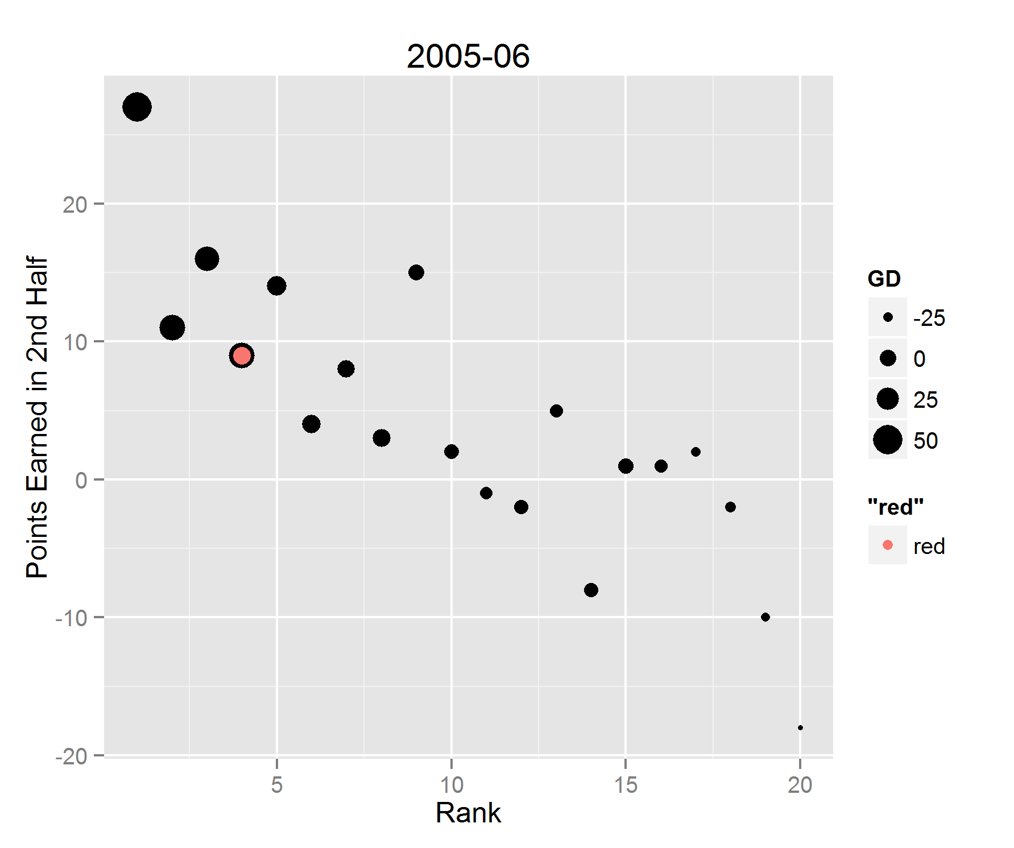
THE EARLY 2000s

Slide 15
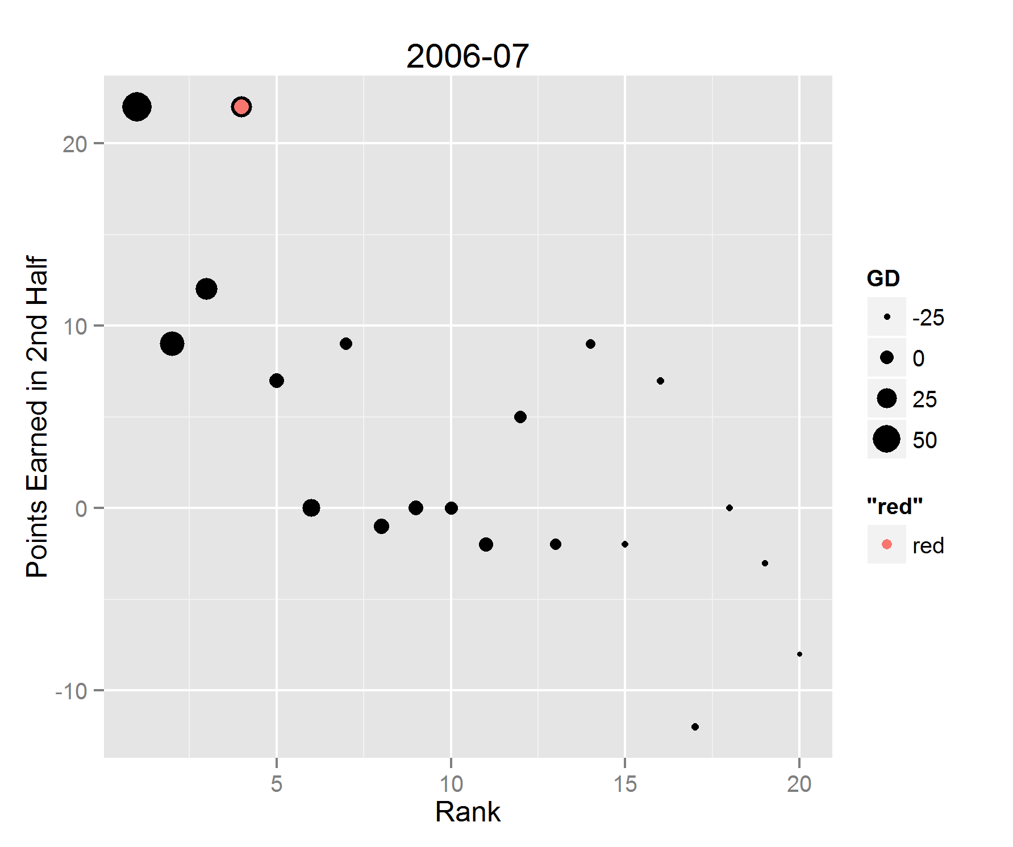
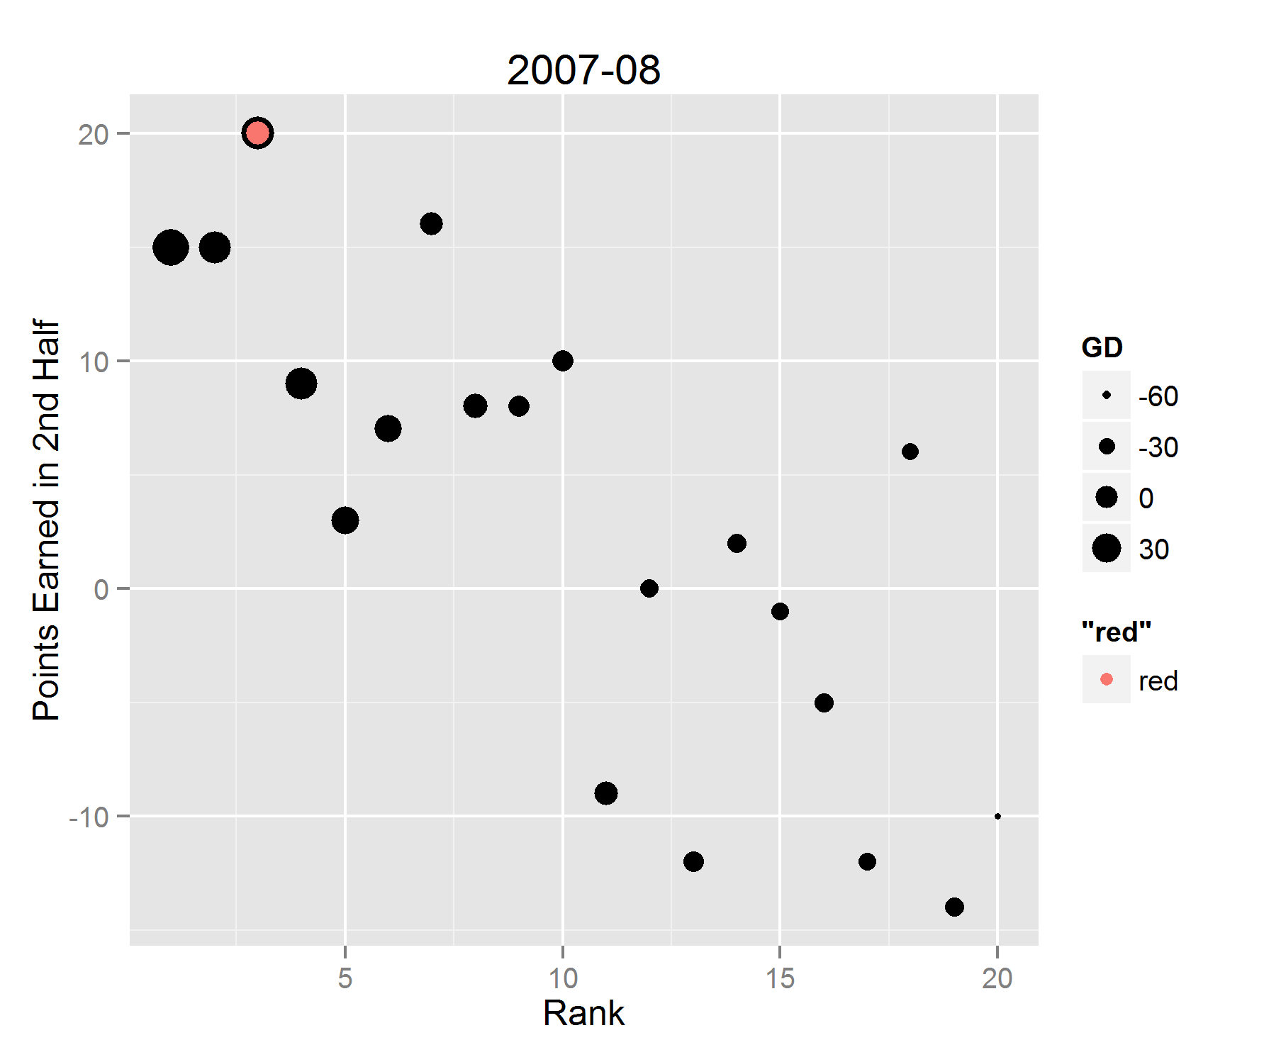
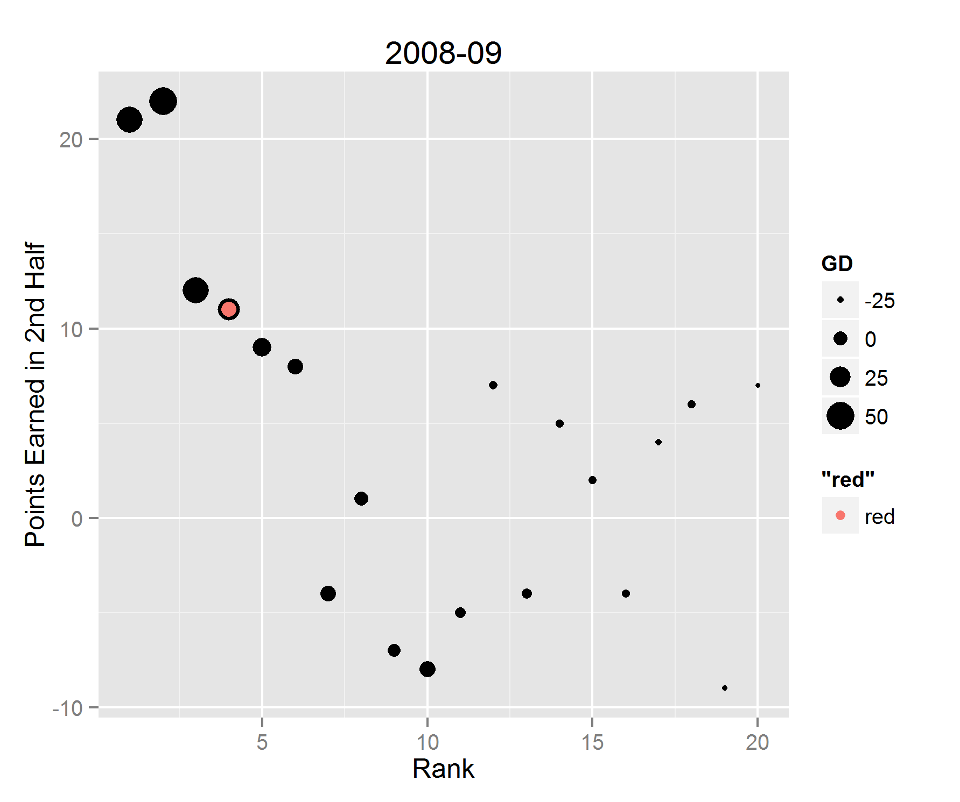
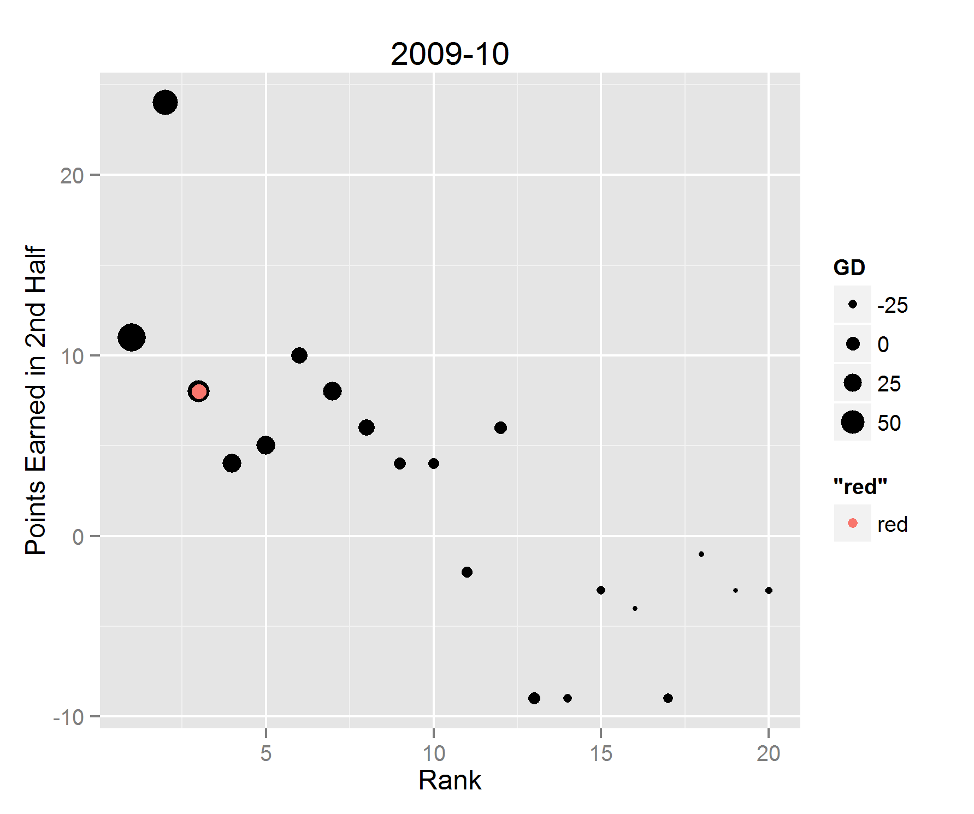
THE LATE 2000s

Slide 16
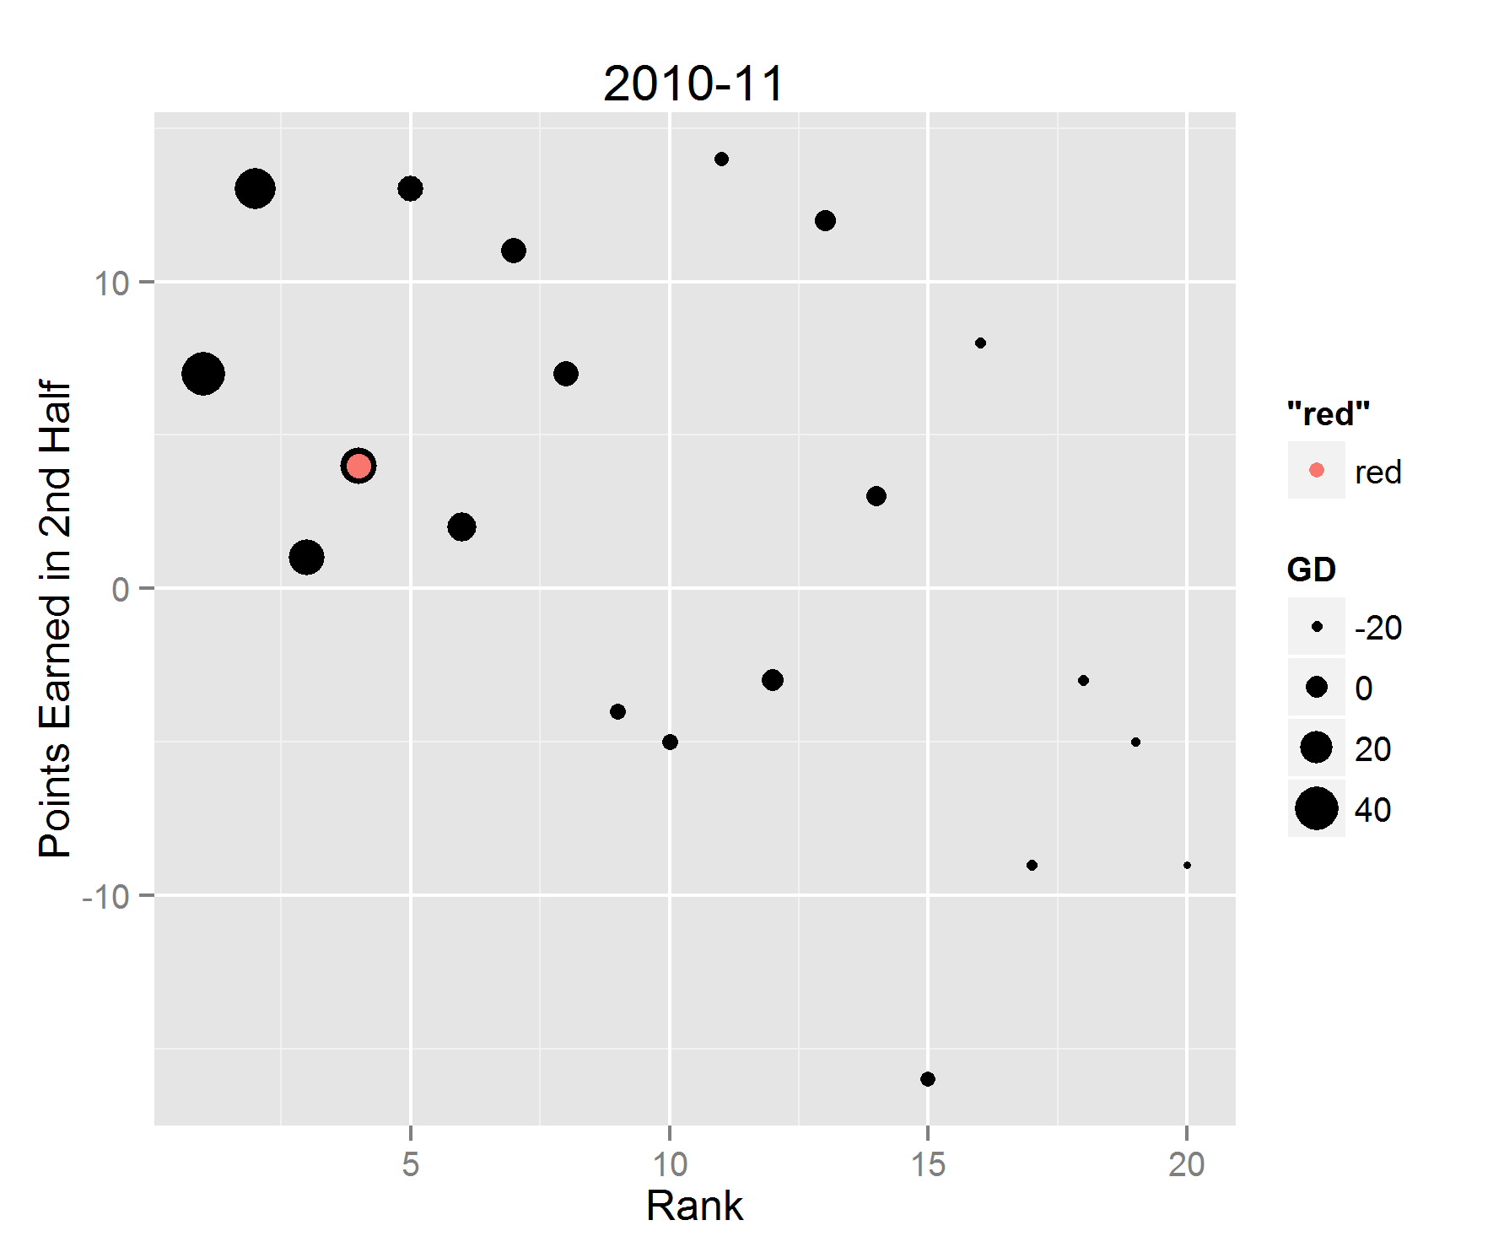
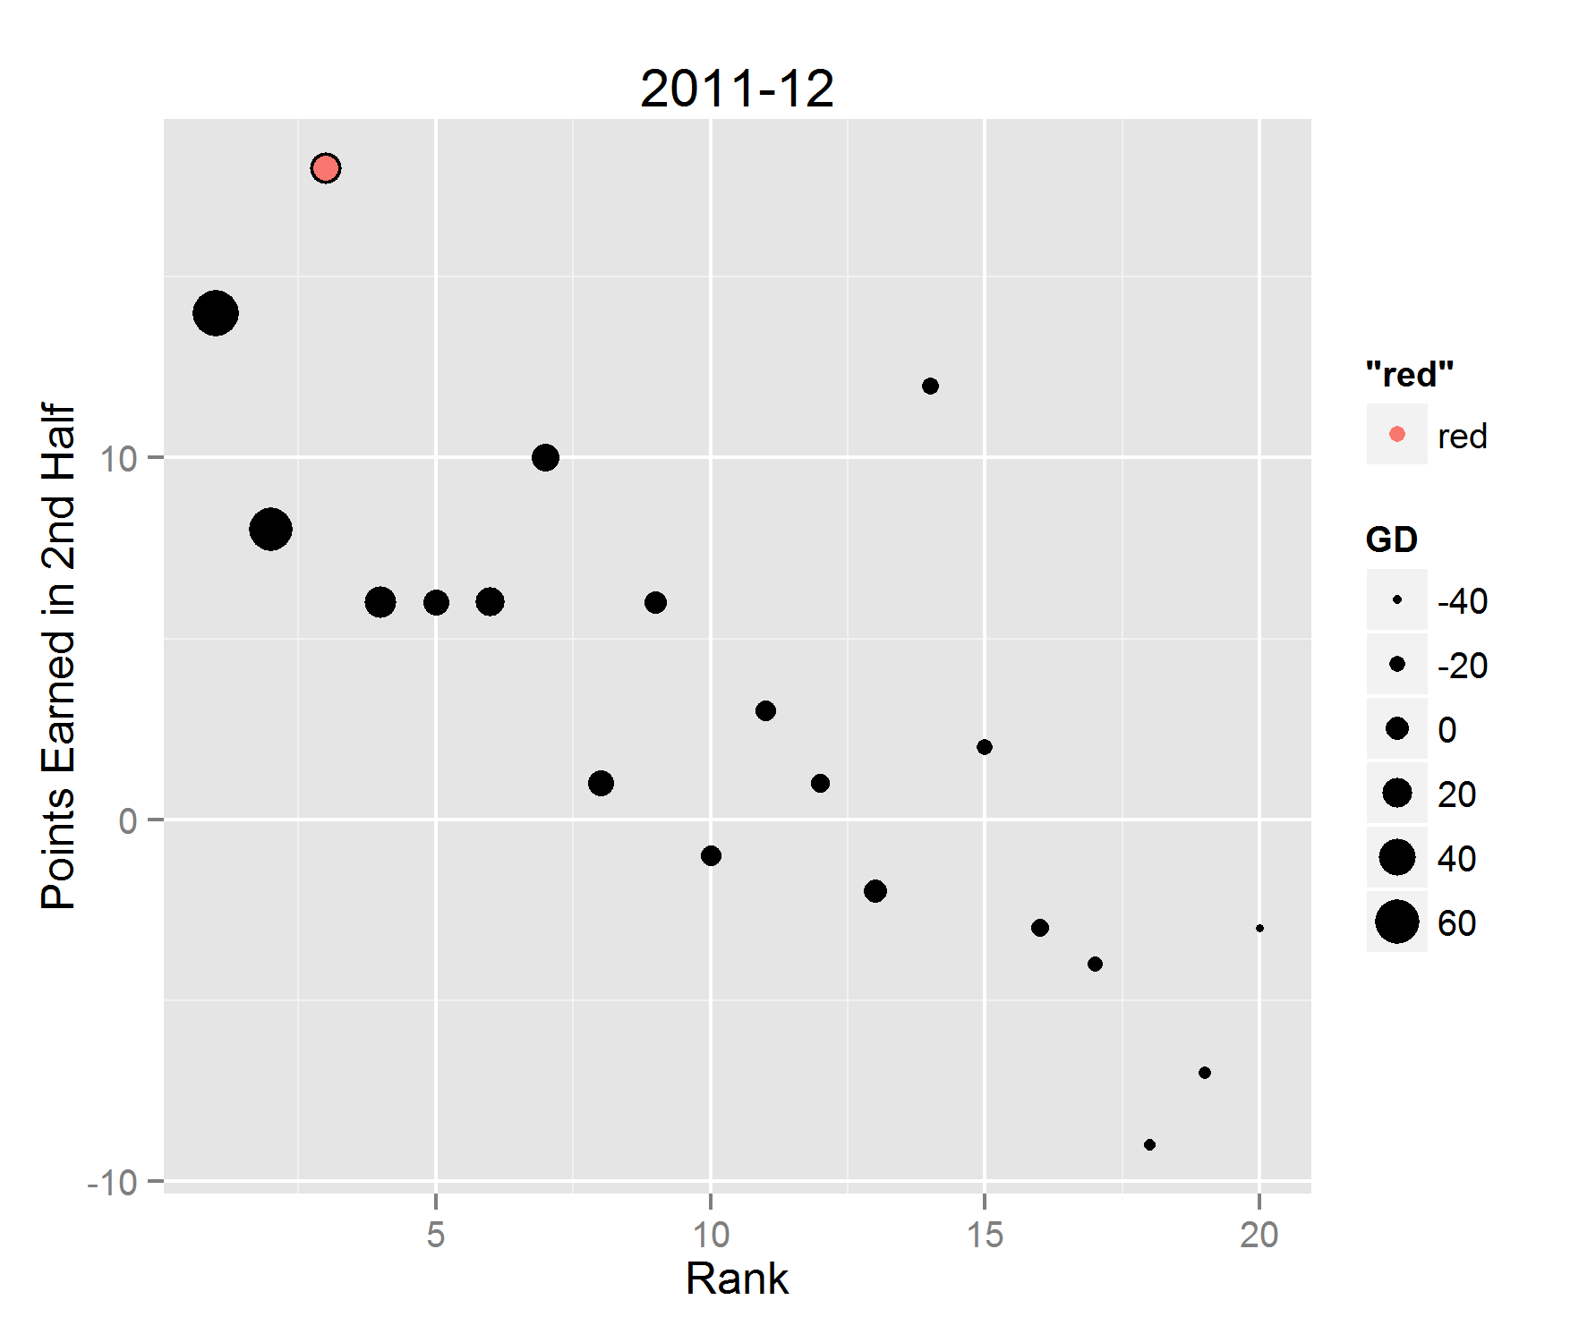
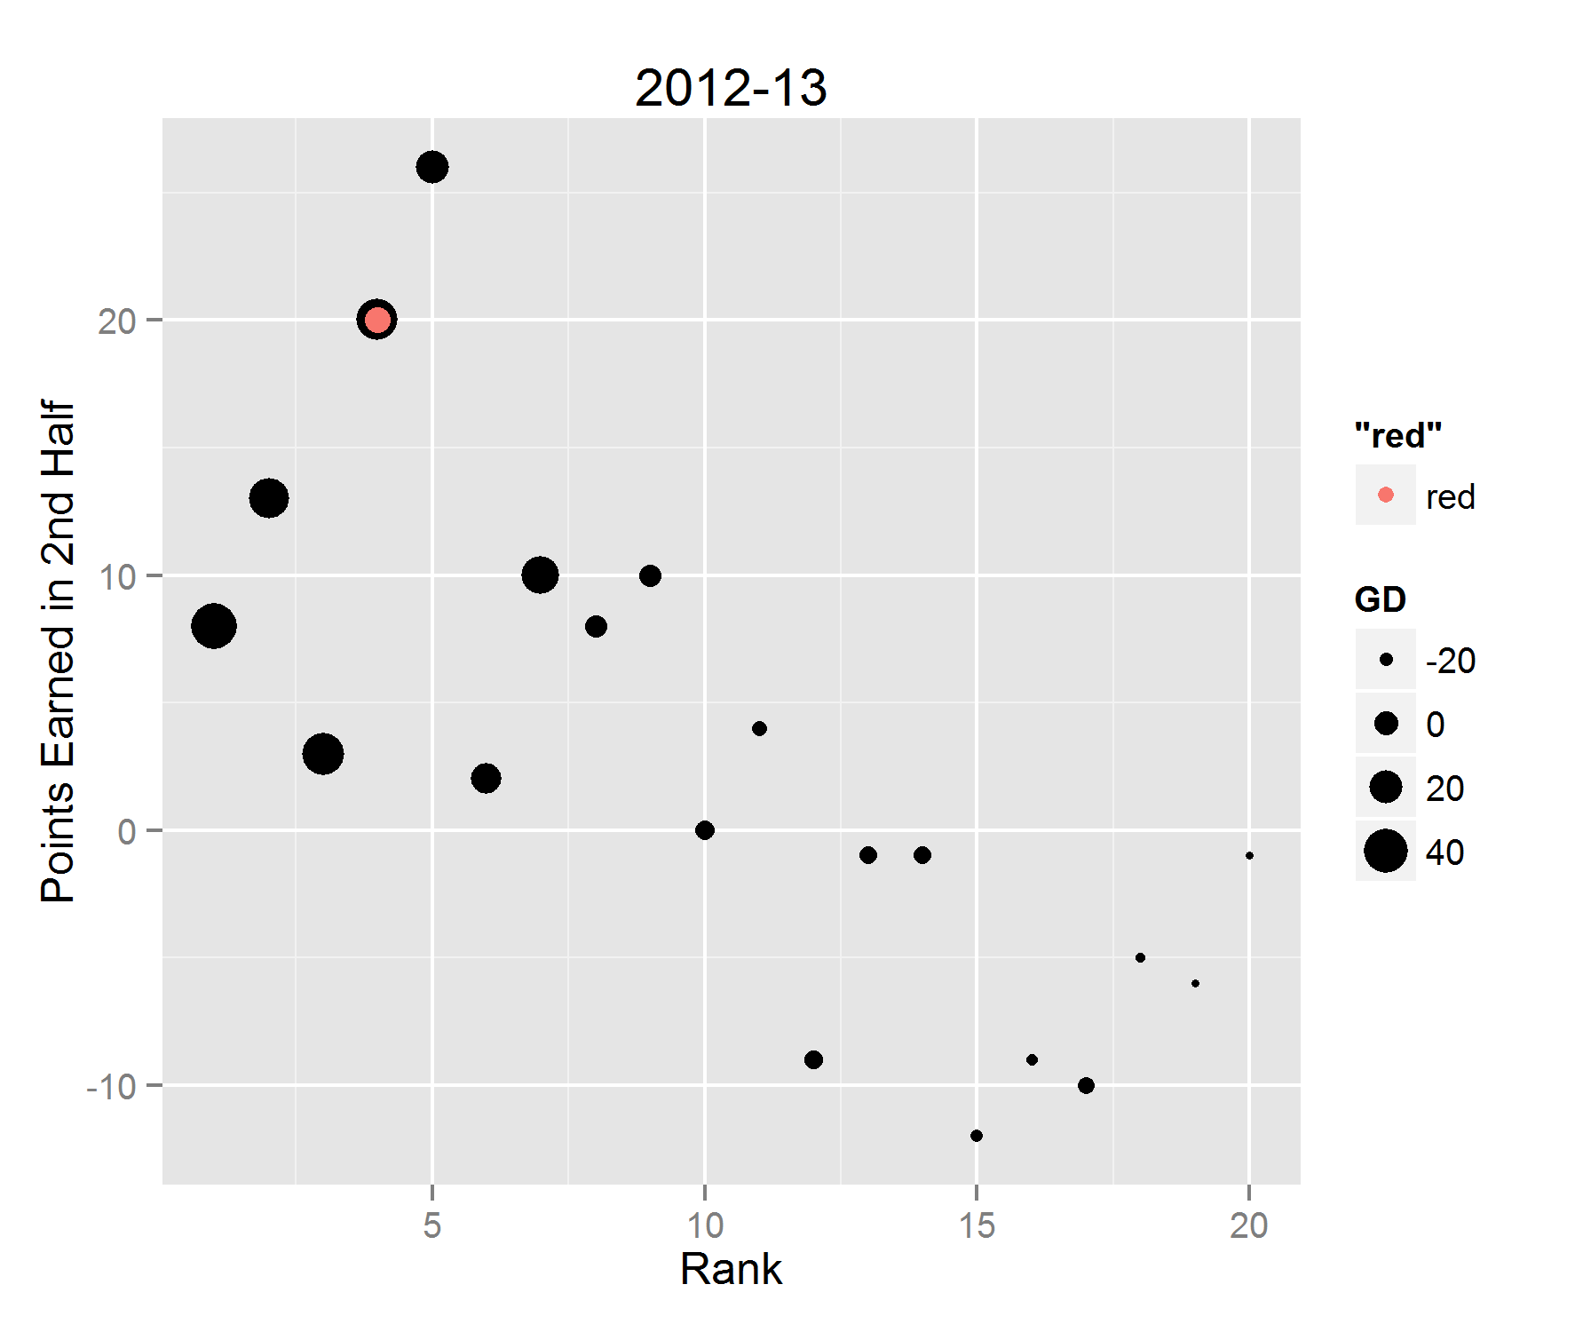
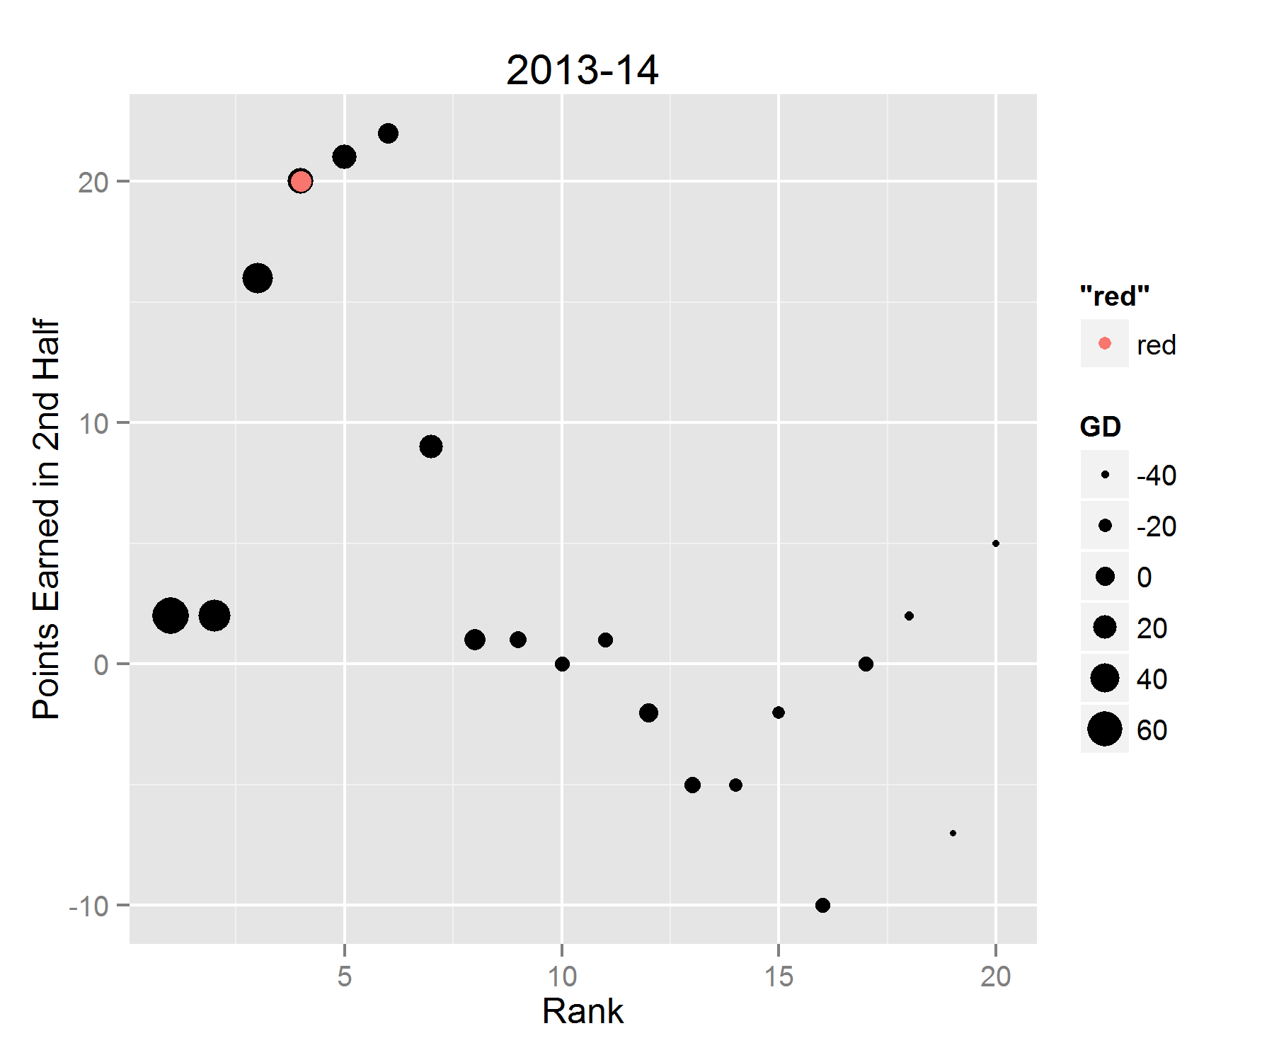
THE 2010s

Slide 17
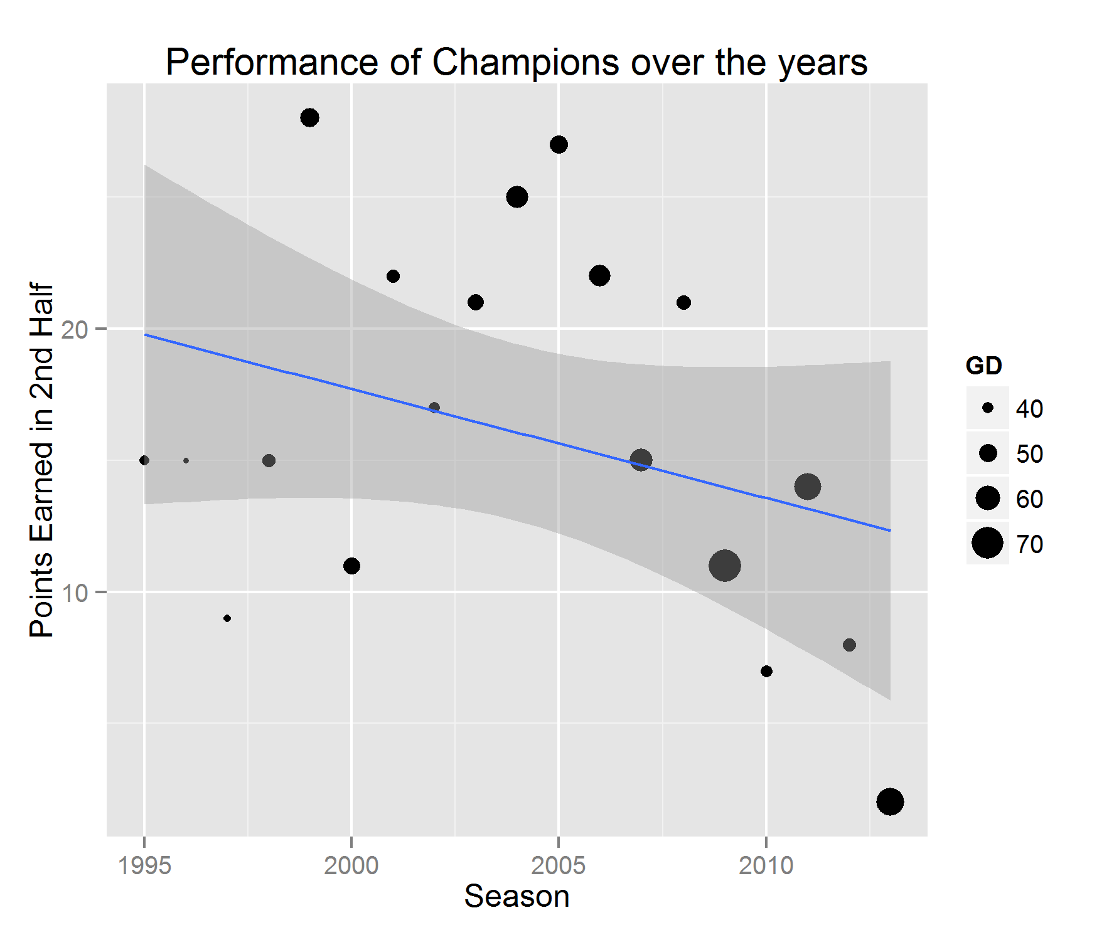

Slide 18
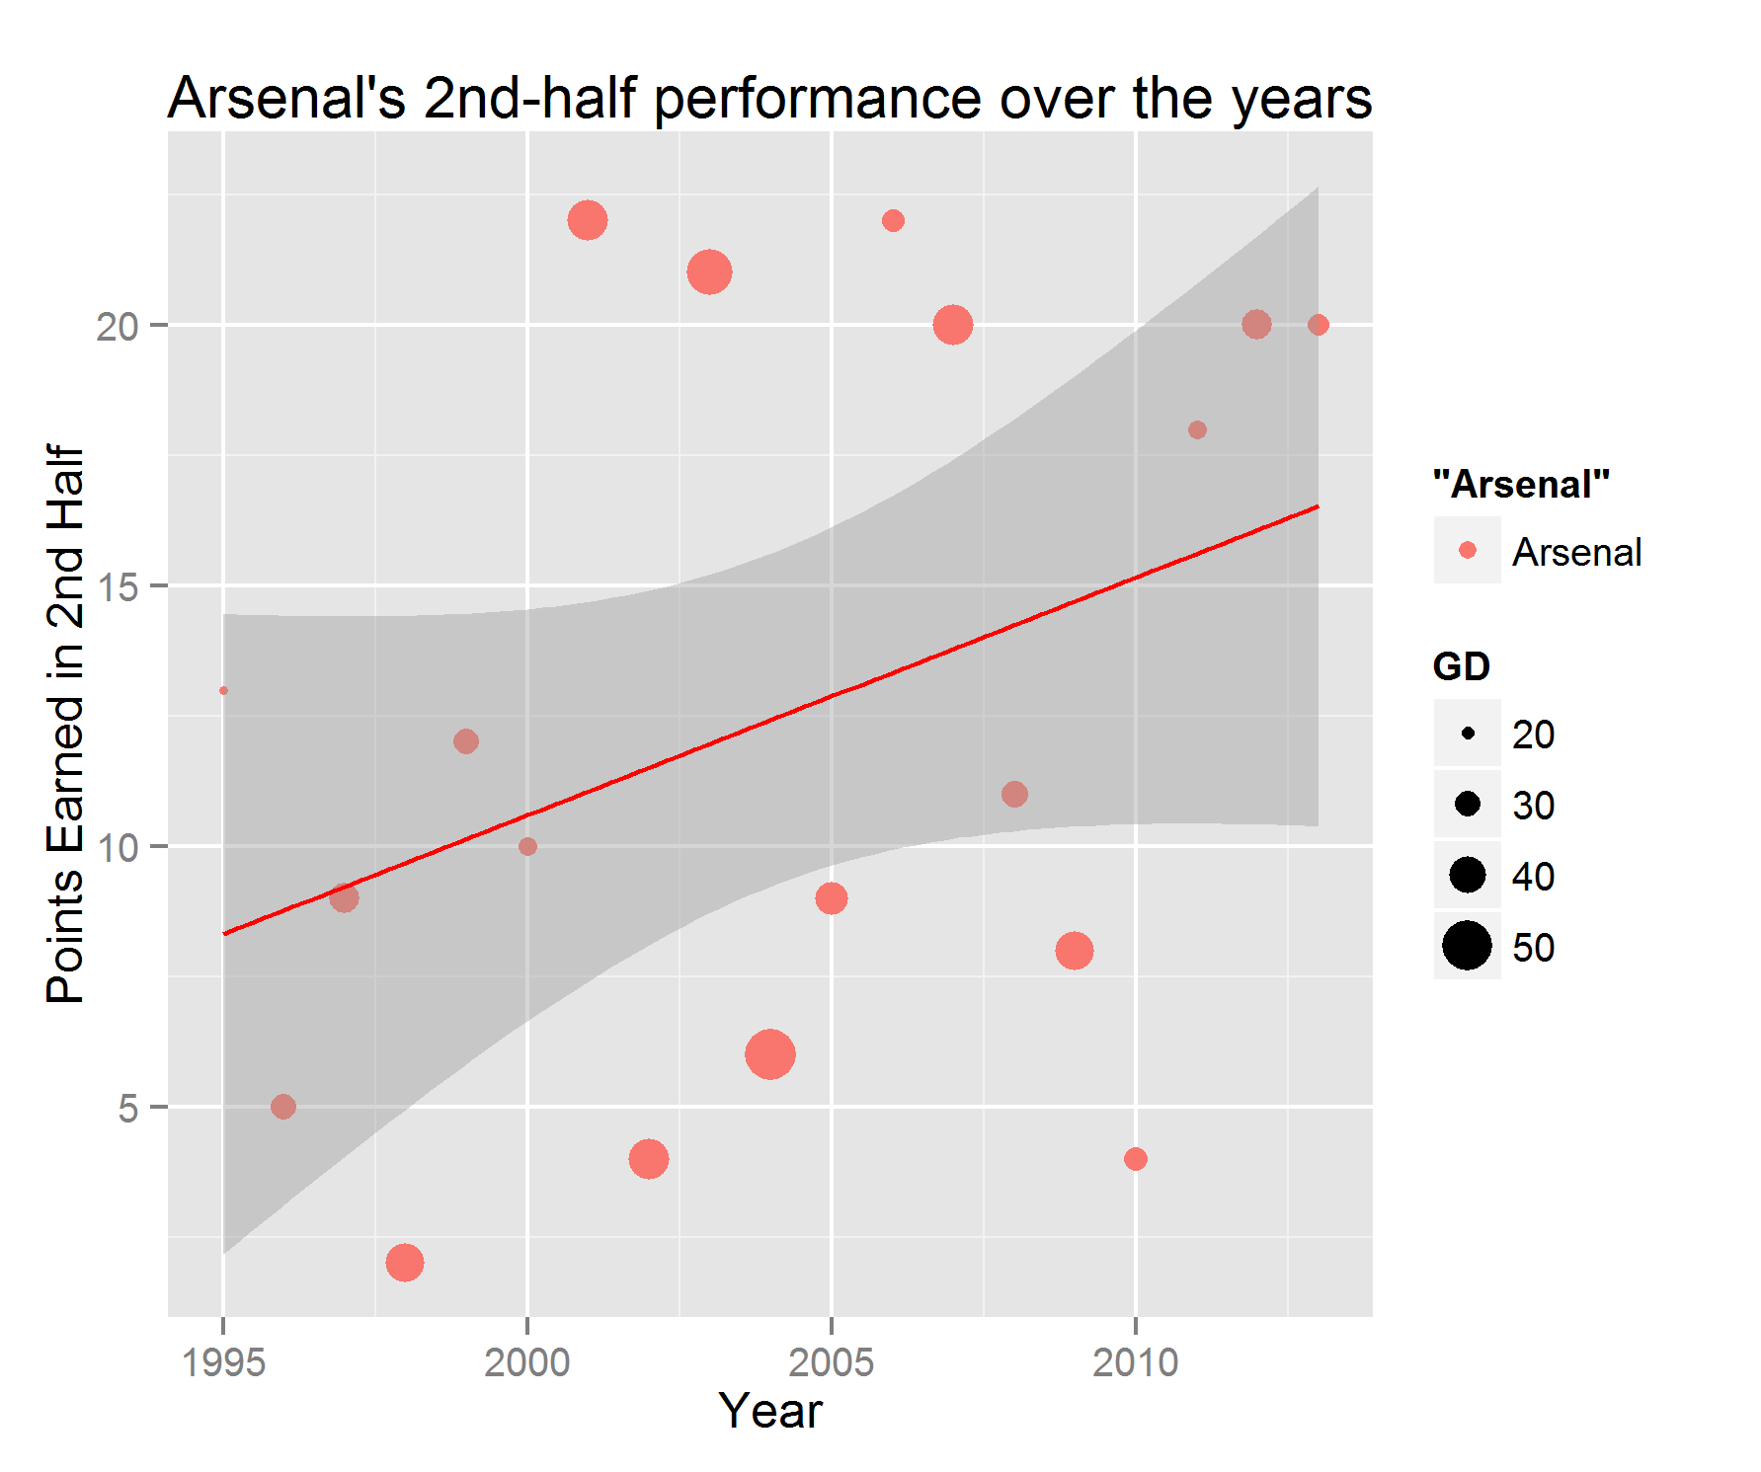

Slide 20
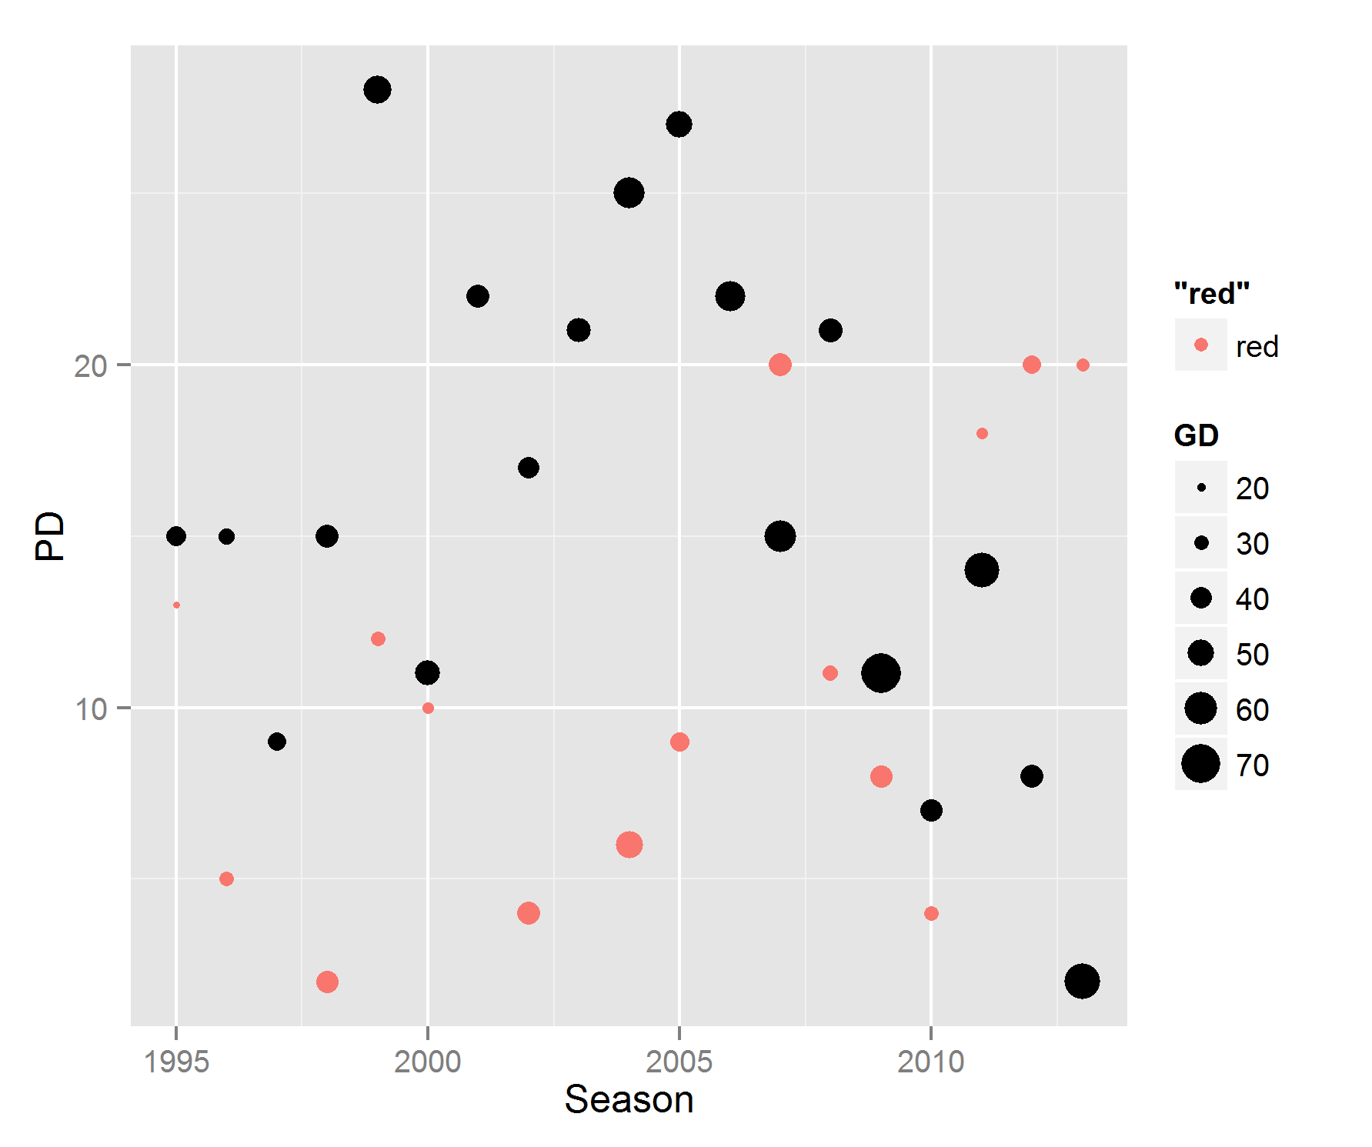

Slide 21
CONCLUSION

Slide 22
conclusion
Arsenal have progressed the exact opposite way than the Champions over the past few years.

Slide 23
THANK YOU

